Slide 1
Uncategorized

Slide 2
Migrate Data from Box to Egnyte - GA
Migrate data from Box to Egnyte using our Content Lifecycle product.
Define what GA means for this product. Must be available to some or all customers to self-serve.
View in Productboard
No Jira Link
Missing requirements

Slide 3
Migrate Data from Dropbox to Egnyte - GA
Migrate data from Dropbox to Egnyte using our Content Lifecycle product. Define what GA means for this product. Must be available to some or all customers to self-serve.
View in Productboard
No Jira Link
Missing requirements

Slide 4
Big File Handling
Prospect says that the 5gb file limit on our Procore integration is a blocker. We want to look into seeing if this is possible and how much work would it be. They are transferring files that are 10 GB already out of Procore. We would need to split files and upload in chunk's as per Procore's API.
Ticket:https://jira.egnyte-it.com/browse/PINT-14789
View in Productboard
No Jira Link
Missing requirements

Slide 5
Ransomware Unification - Replace Ransomware signature source with reputable threat intel source
Confluence page:https://egnyte.atlassian.net/wiki/spaces/DEL/pages/1425834012/Ransomware+Unification+-+Replace+Ransomware+signature+source+with+reputable+threat+intel+source
View in Productboard
DEL-44545
Missing requirements

Slide 6
PCC with Smart Cache (v2)
Automate deployment of Smart Cache in Azure/AWS and create remote desktop environment, so that construction customers who are unfamiliar with public cloud setup can easily provide a virtual environment for their users to work on Revit and GIS files.
View in Productboard
No Jira Link
Missing requirements

Slide 7
Migrate Date from Egnyte to Egnyte (D2D) - GA
Migrate data from one Egnyte domain to another (D2D) using our Content Lifecycle product. Define what GA means for this product. Must be available to some or all customers to self-serve.
View in Productboard
No Jira Link
Missing requirements

Slide 8
APIs for Initiating and Managing Cloud Migrations
Need to offer APIs to initiate and manage migrations
View in Productboard
DEL-41756
Missing requirements

Slide 9
GA for Cloud Migration
The description is empty.
View in Productboard
No Jira Link
Missing requirements

Slide 10
SS on Azure Gov public cloud (FedRAMP certified)
There is requirement from customers especiallyNetCov( an high profile MSP ) to support SS on Azure Gov public cloud due to high compute and performance requirement from their applications.
View in Productboard
No Jira Link
Missing requirements

Slide 11
Domain Without a Trial
As a seller, I want to have my customer use a domain without starting a trial, so that they can use the Egnyte product faster.
Requirements Link:https://egnyte.atlassian.net/wiki/x/IACAP
View in Productboard
APPS-10412
Link to requirements

Slide 12
SC Indication - link to SC view for non-admins
In order to facilitate users moving from CFS to S&G to remediate sensitive content, we should provide them a link that will take them to the SC view with the associated location.
Will require some entitlement changes in S&G
https://egnyte.atlassian.net/wiki/spaces/PM/pages/658374842/SC+Visibility+Phase+2+-+user+actions+workflows
View in Productboard
DEL-38580
Missing requirements

Slide 13
Analysis and Modification of Recommendation Engine Test Results
The description is empty.
View in Productboard
GR-603
Missing requirements

Slide 14
Edit upload request - Due Date & Assignees
Problem Statement
Once the upload request is created, the creator is not able to make any changes to the existing requests.
User Story
As an upload request creator, I would like to edit the existing upload requests so that I can modify the due date and assignees.
Feature Description
• Cretors should be able to edit the in-progress upload requests to modify the due date and assignees
View in Productboard
No Jira Link
Missing requirements

Slide 15
Scalability and large file upload suppport
Problem Statement
When uploading via an Upload Request, the upload goes directly to CFS nodes instead of to EOS (like regular uploads) which limits our ability to support large file uploads and scale the service.
User Story
As an uploader, I want to upload large files quickly so that I can finish my upload request
Feature Description
• Upload directly to EOS instead of CFS
• Increase file size support to multi-GB files
View in Productboard
CFS-61772
Missing requirements

Slide 16
Add item count to SC and Issues pages
Problem Statement
The system has limits on how many objects are displayed on S&G feature pages to prevent long load times (or even completely prevent it from loading). However, because of this limit, it's difficult for user to understand the scope of how many object there actually are.
User Story
As a user, I want a clear understanding of how many issues and sensitive content items I have. This includes filters in place, limits based on the browser resources and total items that the system has identified
Feature Description
Display the counts of the items displayed on the lists
• Issues view - Count of rendered items in the list is displayed
• Ideally we show displayed and total counts
• For example, if there is 10,000 issues in "open status", but I can only display 5,000, the following count should be displayed
• 5,000 of 10,000
• SC view - Count of rendered items in the list is displayed
• Ideally we show displayed and total counts
• For example, if there is 10,000 locations with sensitive content in the current filter, but I can only display 5,000, the following count should be displayed
• 5,000 of 10,000
Public Summary
View in Productboard
DEL-39631
Link to requirements

Slide 17
ServiceNow Incident Sync
Enhancing the ServiceNow functionality to provide bidirectional sync of ticket status and display the ticket in the third pane within the Secure & Govern (S&G) Issues module involves several detailed steps and considerations. Here’s a breakdown:
1.Bidirectional Sync of Ticket Status
• Sync Status Updates from ServiceNow to Secure & Govern: Automatically update the status of tickets in Secure & Govern whenever the status changes in ServiceNow. For example, if a ticket is marked as “Resolved” or “In Progress” in ServiceNow, this update should reflect in the S&G Issues module without manual intervention.
• Sync Status Updates from Secure & Govern to ServiceNow: Allow updates made to the ticket status in Secure & Govern (if any) to sync back to ServiceNow. This ensures that both platforms maintain a consistent view of the ticket’s current state.
• Reduce Communication Gaps: The sync helps eliminate communication gaps, ensuring that teams using Secure & Govern can see the latest ticket status without needing to switch platforms.
• Automated Polling or Webhooks: Implement mechanisms like periodic polling or webhooks to detect and trigger updates between the systems to maintain real-time or near-real-time synchronization.
2.Display ServiceNow Ticket in the Third Pane within Secure & Govern Issues Module
• Clickable Ticket Link: Make the ticket ID or title clickable to open the full ServiceNow ticket in a new window or tab. This provides quick access to the full ticket details if more in-depth review or actions are needed.
• Live Status Updates in Pane: Ensure that the ticket status in the third pane updates in real-time (via the bidirectional sync) so that users have an up-to-date view of the issue’s progress.
• Enhanced Usability: This integration reduces the need for users to switch between Secure & Govern and ServiceNow, improving efficiency for security and operations teams. The third-pane display also helps users get a consolidated view of their issues and related incidents in a single interface.
3.Benefits of the Enhancement
• Streamlined Incident Management: By integrating status updates and a visual display of ServiceNow tickets in Secure & Govern, incident management becomes more streamlined, as users can track and respond to incidents directly.
• Improved Transparency and Communication: Both the security and IT teams gain access to the latest status, improving transparency and collaboration. Secure & Govern users can see real-time ticket information without accessing ServiceNow directly.
• Efficient Workflow: Eliminates redundant steps of switching between platforms, saving time and reducing errors.
View in Productboard
No Jira Link
Missing requirements

Slide 18
Windows 11 24H2 Support as Client
The description is empty.
View in Productboard
No Jira Link
Missing requirements

Slide 19
Windows Server Next ( 2025 )
The description is empty.
View in Productboard
No Jira Link
Missing requirements

Slide 20
PVI - Milestone 14.1 - Accuracy of Deployment
Background and Strategic Fit:
Currently, there are thousands of PVIs created over time due to various customizations. A plan created with a different price, a different user/storage, or feature set requires a new manual PVI close. Also there is no formal association between a cloned PVI and its source PVI for audit purposes. PVIs have a static structure as well. This means that once a PVI is created it does not reference new features or services developed in the future. We are set to re-imagine this and create a new architecture that will allow MI to be more flexible.
Goals:
• Start identifying items that can be automated or updated to improve the speed of features being released.
View in Productboard
APPS-11863
Missing requirements

Slide 21
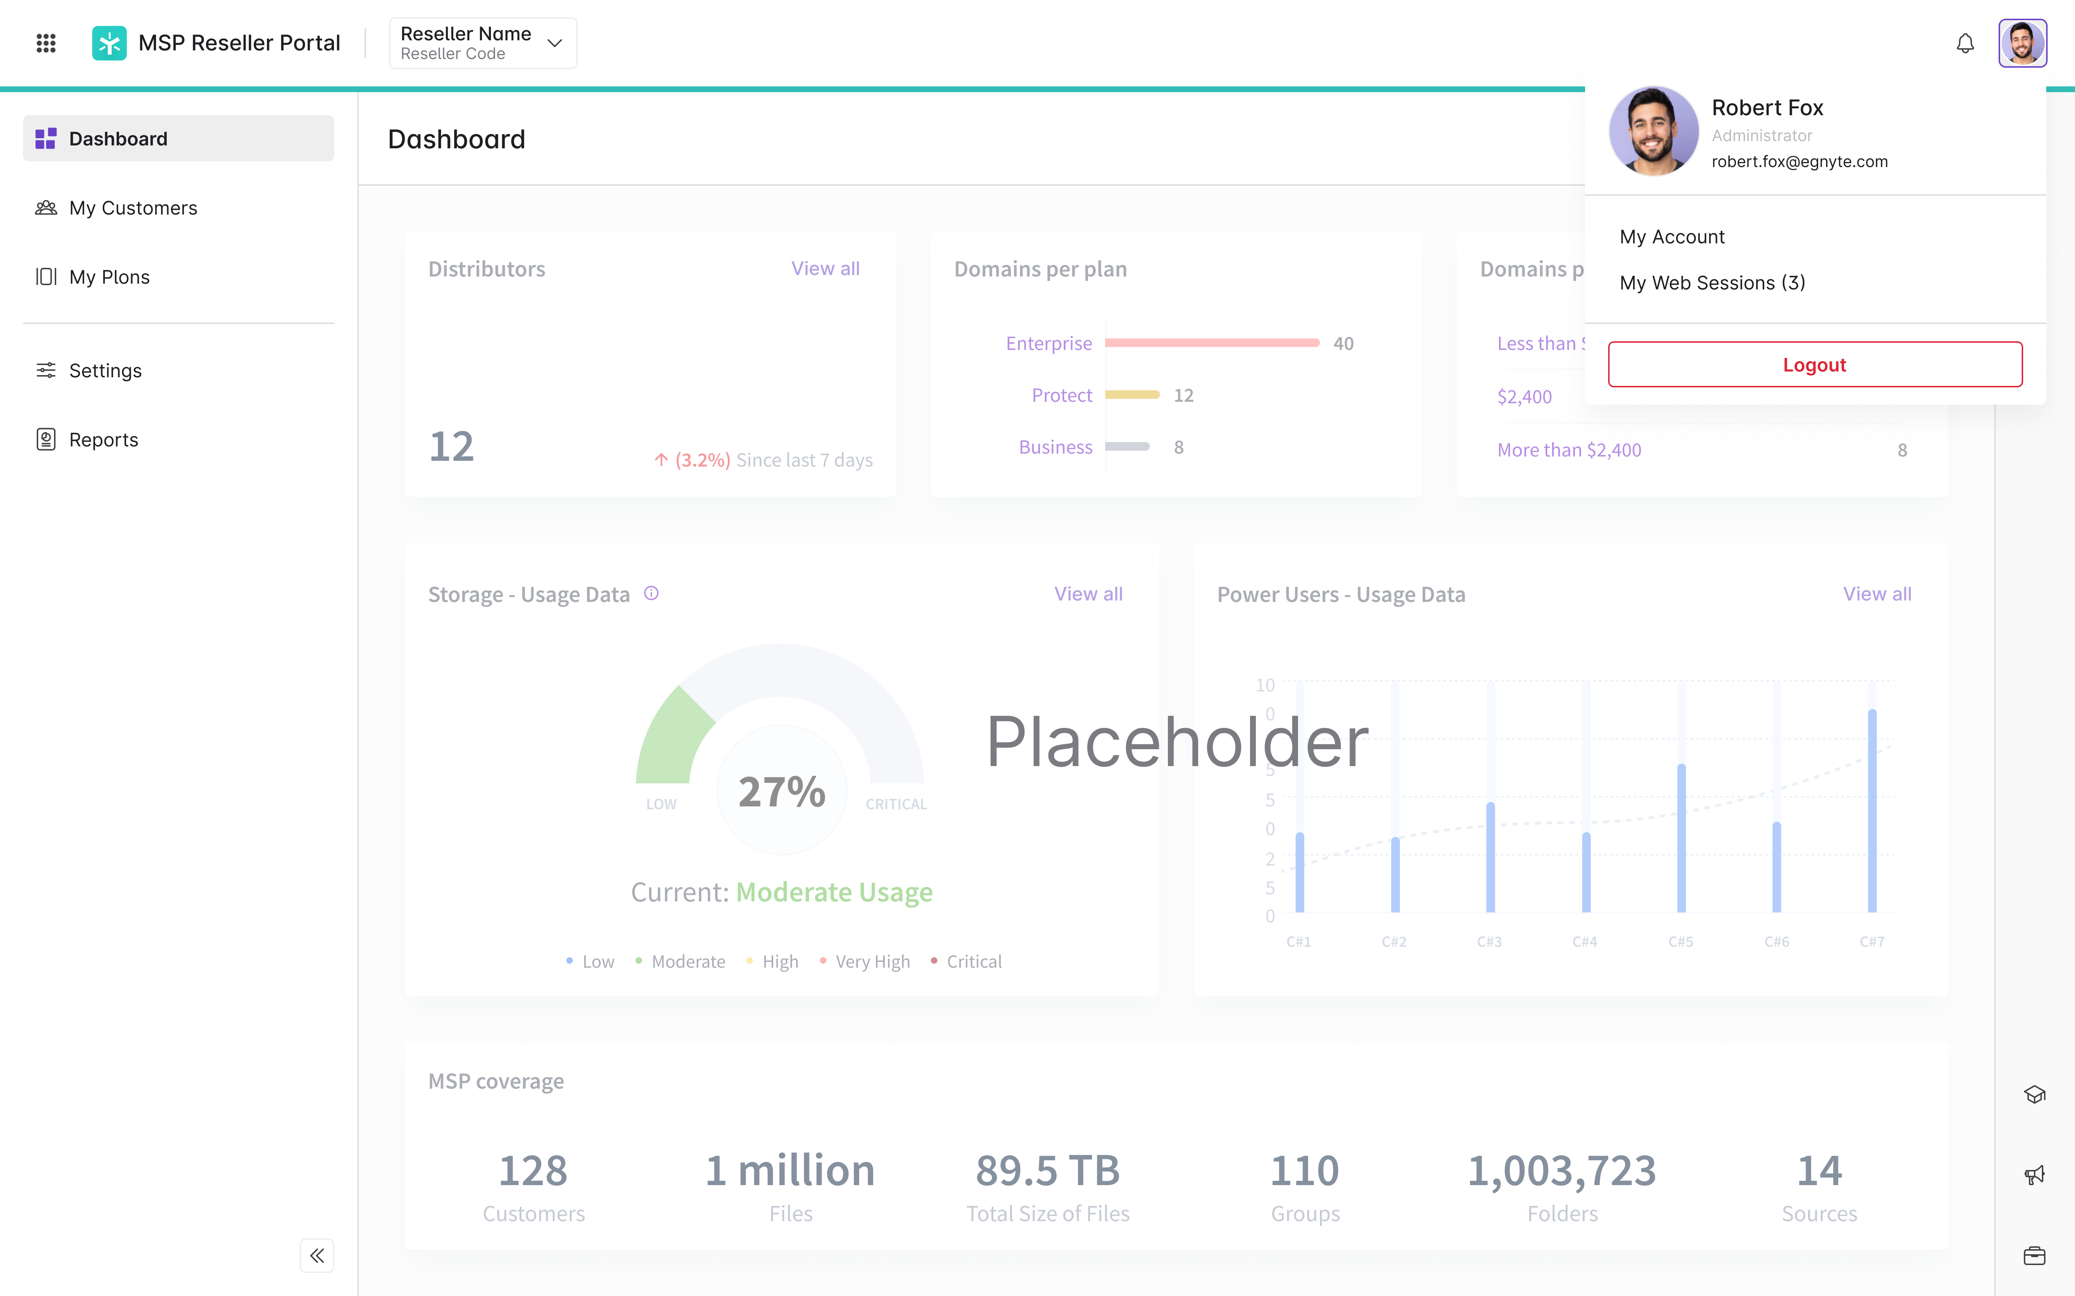
[UX] MSP RD Designs part 3 - multiple pages
Problem Statement
MSP Reseller Dashboard is used by MSP partners manage the child domains, access to them for their employees and also allows to self-serve purchase transactions. Currently the interface is not aligned with Egnyte look and feel and some parts of it are not design properly for the comfort and easiness of our partners.
User Story
As an Egnyte staff user I want to manage a Pax8 MSP so that Egnyte can sell products through a Distributor.
Feature Description
• Prepare designs to organise the application according to the best UX practices and adding the look and feel currently used in other Egnyte applications.
• For Q2 work on designs for several tabs:
• My Users
• User profile
• My Company
• Configuration
• Dashboard
• Contract link & Pricing
View in Productboard
APPS-11774
Link to requirements

Slide 22
Issues as tasks in CFS [POC]
Motivation
This epic is part of an effort to increase the visibility of S&G product in CFS and to increase the adoption of S&G features, especially for non-admin users. Issues are one of the candidates for showing them as tasks in CFS. This POC aims to provide a starting point for syncing other S&G workflows that can be represented as tasks (e.g. folder reviews).
Objectives
Make issues appear under tasks in CFS. Syncing process can be periodic although investigate event-like mechanisms for syncing.
Only delegated (assigned) issues are to be synced in order to limit the number of tasks visible to the user. Otherwise having some tenants/domains with the issue numbers in the order of 1M might flood the user with information and make working with tasks impossible.
Tasks should appear undertabs not {}, because issues are detected by the system. Also for tasks shown inside workspaces the list of issue tasks should be filtered by workspace folders. Issues not located in any folder should not be displayed in workspace tasks.
On clicking the issue task user should be redirected to S&G to issues view with a single issue visible. S&G page should be opened in a separate tab.
Design the storage of tasks in such a way that it's possible in the future to show custom columns (like priority, detection rule name) and apply sorting and filtering by these columns. It should be possible to choose visible columns from the columns picker. The actual frontend mechanisms for selecting columns and backend mechanisms for filtering and sorting are out of scope. Also design the storage so that details of a task can be displayed in a popup/sidebar or fetched on demand from S&G.
Design the storage to support actions on an issue task possible to be triggered directly from CFS. The actual logic for the actions should be executed on S&G side. The actions could allow dismissing, remediating and delegating the issues to someone else without leaving CFS. Actions will need to have contextual messages depending on issue type and issue state.
Concerns
With new auto remediation and auto delegation features it's possible that some clients will generate a lot of delegated issues. Right now only 2 paid clients have more than 1k delegated issues.
Consider whether it's possible to add issue-specific features to tasks
References
Task object fields and values -https://egnyte.atlassian.net/wiki/spaces/CFS/pages/1138294824/Task+model
Original confluence overview -https://egnyte.atlassian.net/wiki/spaces/DEL/pages/1178042554/Integrate+S+G+Tasks+into+CFS+Task+List
Sensitive content review workflow proposal -https://egnyte.atlassian.net/wiki/spaces/DEL/pages/1003978931/Sensitive+Content+Review+Workflows
S&G tasks data model -https://egnyte.atlassian.net/wiki/spaces/DEL/pages/1140031504/Data+model+for+folder+review+and+issue+tasks
View in Productboard
DEL-43484
Missing requirements

Slide 23
Convert Google OCR PoC to a production grade integration
Confluence documentation ~~>HERE
The current integration of Google OCR within the S&G extraction pipeline is a limited PoC. It needs additional development to convert it to a production ready service. Those tasks are captured in this Epic.
TODO: Tickets for Scheduling & Polling of the batch requests, once the vision is clear (mby some updated diagrams?)
View in Productboard
DEL-42652
Missing requirements

Slide 24
Splunk App Tech-debt
This is a blanket epic to address some of the Tech-debt, Security and Observability tasks.
Reference:https://egnyte.atlassian.net/wiki/spaces/PINT/pages/1101791255/4Q2024+Splunk+plugins+knowledge+transfer+leftovers+and+priorities
View in Productboard
No Jira Link
Missing requirements

Slide 25
Include original/destination path in stub file
Problem Statement
There have been escalations created due to customers moving stub files so the stub file no longer matches the source/destination.
User Story
Support has requested that the original source and destination paths be included in the stub file text to avoid confusion/escalations when this happens
Feature Description
Beneath the standard text but before custom text in the stub file, the new information should be included:
• Original file location (domain and path)
• Original archive destination (domain and path)
Public Summary
Egnyte provides access to all files in a customer's domain, including the system-generated stub files that are left by processes like content lifecycle policies. In some cases, these stub files are moved which can cause confusion when a user look at the text. To avoid that confusion, we want to include the original file source location as well as the original archive destination in the stub text.
View in Productboard
DEL-44393
Link to requirements

Slide 26
Setting Webhook limit at the domain level using FF
Issue:Currently, the webhook limit is set at the data center (DC) level, meaning any increase in the limit applies to all customers. This is not ideal from a scalability and load management perspective. As a result, individual customers requesting a higher webhook limit cannot be accommodated without impacting others. The current webhook limit is 10 for all customers.
Solution:To address this, we need to introduce a domain-level feature flag that allows for a higher webhook creation limit based on customer demand and specific use cases. This will enable us to grant exceptions to select customers without affecting the overall system performance.https://jira.egnyte-it.com/browse/PINT-14850
View in Productboard
No Jira Link
Missing requirements

Slide 27
Presto Portal For Partners
The description is empty.
View in Productboard
No Jira Link
Missing requirements

Slide 28
Procore Power Users -> widget
Story: Procore WidgetAs a user with the Procore integration enabled,I want to configure and manage my Procore project sync from the dashboard, so that I have full visibility into my files syncing to and from Procore
Acceptance Criteria:
1. UX design is required and that is available already
2. A new Procore widget should be created on the Dashboard.
3. Once configured, the widget should include the Procore Project being synced, the Egnyte folder selected for syncing, the last successful sync, and the service account used.
4. The widget should be visible on the project dashboard only for users that have enabled the integration.
5. Admins or PUs with permissions to configure the Procore Project sync should be able to initiate the configuration directly from the Project Dashboard widget.
6. Admins or PUs with permissions to configure the Procore Project sync should be able to stop and remove the connection directly from the Project Dashboard widget.
7. Users without permissions to configure the Procore Project sync, but with the ability to view the project folder should be able to view the status of the Procore connection from the widget
Resources:
• https://egnyte.atlassian.net/wiki/spaces/AEC/pages/1262190598/Procore+Widget+Requirements+-+Project+Dashboard
• https://www.figma.com/design/ZBxPaDgTrrYniqCXSU4D4L/AEC-~~-Procore-dashboard-widget-~~-Q1-2025?node-id=1-4&p=f&t=17kEzoN1x59VZ6ve-0
Expectation for Q2-2025:
1. Development is expected to be completed by Q1 and GA by Q2.
View in Productboard
No Jira Link
Missing requirements

Slide 29
[GA] Preview Analytics
Problem To Solve
Team managers lack insights into how users engage with important documents like training materials, limiting their ability to assess content effectiveness and improve user engagement.
User Story
As a team manager, I want to see how much time users spend on individual pages of PDF documents so I can evaluate document usefulness and identify areas needing more attention.
Feature Description
Enable preview analytics tracking on mobile by capturing time spent on PDFs. Mobile will collect heartbeat data (user ID, group ID, object ID, page number) to ensure time spent on documents is included in the webUI insights. Phase 1 is limited to PDFs, with a file-agnostic method planned for future reuse.
View in Productboard
IOS-13443
Link to requirements

Slide 30
New Homepage (iOS)
We are creating a new homepage for our mobile app to enhance user productivity and streamline access to key features. This homepage will integrate various widgets and quick access links, offering users a more personalized and efficient experience. By allowing customization and ensuring seamless synchronization between the web UI and mobile app, users will have a consistent and intuitive interface across all platforms.
Homepage requirements:
1. Widget Display and Interaction -As a user, I want to view widgets like Egnyte Copilot, Bookmarks, Recent Files, and Project Folders, on the homepage so that I can quickly access relevant content and actions.
2. Quick Access Links -As a user, I want to have quick access links on the homepage for actions I often perform like File Upload, and mobile-specific features like Smart Upload updates, so that I can perform tasks efficiently from the homepage.
3. Widget Customization -As a user, I want to be able to customize my homepage by showing or hiding specific widgets so that my homepage displays only the information and tools I need.
4. Sync Settings Across Mobile Devices -As a user, I want my widget settings (show/hide preferences) to be synced across all my mobile devices so that my homepage layout remains consistent regardless of the device I use.
View in Productboard
No Jira Link
Link to requirements

Slide 31
Track sensitive content indicator labeling
Problem Statement
The sensitive content indicator is of high interest to senior leadership, so we're going to need to track what customers have the SCII labeling policy enabled.
User Story
As an feature owner, I need to be able to report on the usage of all released features
Feature Description
The sensitive content indicator is of high interest to senior leadership, so we're going to need to track what customers have the SCII labeling policy enabled.Information needed:
• Tenant ID
• Tenant name (nice to have)
• Policy state (enabled/disabled)
• Associated CC policies (policy ID)
• Associated sources (source ID)
• Number of files labeled
• Update schedule TBD (maybe every 24 hours)
If it's built for generic doc labeling info:
• Mark individual patterns (yes/no)
• Write persistent labels (yes/no)
• Policy name
• Description
Ideas:
• Make information available in admin panel
• This may be quick solution, but might only be for the SCII (and LPTR) labeling policy
• Make information available in BQ
• Would be usable by more teams (like the data team)
• Could be expanded to include all labeling policies
Public Summary
This is an internal-only feature. As we continue to expand the scope of document labeling, we need a better mechanism to track the usage of the feature. This work will allow for more robust reporting on how customers are using document labeling.
View in Productboard
DEL-44434
Link to requirements

Slide 32
[S&G] Unusual Access - Abnormal Move/Copy Detection + Reduce Explorer False Positives
https://egnyte.atlassian.net/wiki/spaces/DEL/pages/1538884626/Unusual+Access+-+Productize+POC+MVP
View in Productboard
No Jira Link
Missing requirements

Slide 33
Move /Copy redesign (Android)
Description:
Redesigning move and copy workflow for files and folders to provide a more intuitive experience.
View in Productboard
MOB-18003
Link to requirements

Slide 34
AI - Copilot Hub (Android)
Problem Statement:
Every organisation is producing additional information on a daily basis. This information is captured in forms of documents and is stored on Egnyte Platform. Employees find it hard to stay updated with this evolving information landscape.
User Story:
As a user, I want an easy way to discover and use the interface to interact with the KB and get relevant information.
Feature Description:
• Knowledge base chat interface to be available for users to interact with files using prompts, suggestions and self-typed questions.
• Users can copy responses and provide feedback on responses generated.
View in Productboard
MOB-19307
Link to requirements

Slide 35
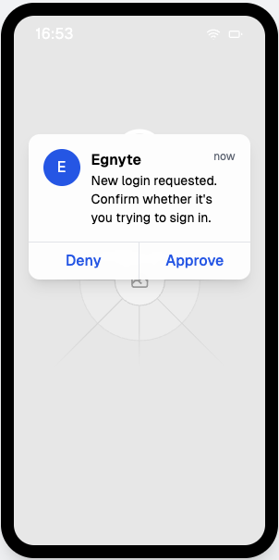
2FA using Egnyte iOS App
Problem Statement
Egnyte users currently rely on third-party 2FA methods, creating friction and a disjointed login experience. There’s a need for a secure, integrated 2FA option using the Egnyte mobile app to simplify authentication and reduce dependence on external tools.
User Story
As an Egnyte mobile app user, I want to use the Egnyte app as a two-factor authentication (2FA) method when logging into Egnyte via the web UI, so that I can securely access my account without relying on external 2FA tools or devices.
Feature Description
• Users should be able to use their devices with the Egnyte Mobile App as a TFA method
• A push notification should be presented to users, directing them to the mobile app
• Users should be able to confirm/decline a new login
View in Productboard
IOS-14110
Link to requirements

Slide 36
AI - Ask Q&A(Android)
Problem Statement:
It is tedious for users to review long documents and find relevant information. Ask Q&A capability allows users to interact with the document.
User Story:
As a user, I want a convenient and interactive, AI-powered document Q&A feature that allows me to ask questions (including suggestions and prompts) related to specific documents directly on my mobile device to get relevant information.
Feature Description:
• Ask Q&A feature to be available for text and image files for users to interact with files using prompts, suggestions and self-typed questions.
• Users can copy responses and provide feedback on responses generated.
View in Productboard
MOB-17577
Link to requirements

Slide 37
2FA using Egnyte Mobile App (Android)
Problem Statement
Egnyte users currently rely on third-party 2FA methods, creating friction and a disjointed login experience. There’s a need for a secure, integrated 2FA option using the Egnyte mobile app to simplify authentication and reduce dependence on external tools.
User Story
As an Egnyte mobile app user, I want to use the Egnyte app as a two-factor authentication (2FA) method when logging into Egnyte via the web UI, so that I can securely access my account without relying on external 2FA tools or devices.
Feature Description
• Users should be able to use their devices with the Egnyte Mobile App as a TFA method
• A push notification should be presented to users, directing them to the mobile app
• Users should be able to confirm/decline a new login
View in Productboard
MOB-19546
Link to requirements

Slide 38
Value Scorecard MVP
The description is empty.
View in Productboard
GR-457
Missing requirements

Slide 39
Provide Sensitive content on 'Unpermitted locations' via OLAP
Data populated on the S&G dashboard consists of Sensitive content locations across all locations - not just "Unpermitted Locations". We require the ability to look at SC across only Unpermitted locations.
View in Productboard
DEL-38410
Missing requirements

Slide 40
Disable new folder creation in MS Teams Integration
Product Requirement: MS Teams Integration – Folder Creation Control
Use Case
In the MS Teams integration with Egnyte, when users add a new Egnyte tab, they are prompted to either select an existing folder or create a new one. Choosing to create a new folder automatically generates a folder and an Egnyte group within /Shared/Microsoft Teams Files.
Problem Statement
1. Slow Folder Creation – Creating a new folder takes a significant amount of time, causing delays\.
2. Duplicate Folder Issues – Newly created folders often result in duplicate entries within \/Shared\/Microsoft Teams Files, specifically landing in a duplicate folder \(e\.g\., *Red Bull \(1\)*\)\. This leads to confusion and clutter as more duplicate locations accumulate over time\.
3. Access management - content is uploaded to the folder where access is not controlled
Proposed Solution
Introduce an Admin-controlled setting todisable the option to create new foldersduring setup. When enabled, users will only be able to select from existing folders where they already have access.
Value Proposition
• Improves User Experience – Reduces folder creation delays\.
• Eliminates Duplicates – Prevents multiple duplicate folder locations, ensuring a cleaner structure\.
• Enhances Control – Allows Admins to enforce folder management policies and maintain a more organized file system\.
• Reduces Confusion – Ensures users work within existing authorized folders, avoiding misplaced files\.
https://jira.egnyte-it.com/browse/COM-268
https://jira.egnyte-it.com/browse/SER-3461
View in Productboard
No Jira Link
Missing requirements

Slide 41
Other Plans for Prospects: Plan Exploration & Trial Management
The current Plan Details page, written with outdated technology, requires a rewrite to align with Egnyte standards. Transitioning to a Common UI framework is critical, enabling integration with CFS navigation and improving the overall user experience. Additionally, recent industry trends have shifted towards a preference for self-service and personalized interactions, emphasizing the need for prospects to access pricing details, research product specifications, and initiate free trials without direct sales involvement. This shift, supported by findings from over 2,000 technology buyers, highlights the necessity for transparent pricing and direct access to free trials to meet customer expectations and remain competitive, particularly in light of practices adopted by companies like Microsoft and Google.
The Trial Add-Ons feature was the first phase of this initiative, allowing customers to explore additional features during their trials. The next phase of this project is the introduction of the Other Plans Page, which will provide a more comprehensive experience for prospects. This page will give users a centralized location to explore, trial, and upgrade plans, further enhancing the self-service experience and aligning with the evolving market demands.
Presentation to e-staff on 2/27/24https://egnyte.egnyte.com/dl/CFwIo6sFGk
Goals:
• Provide aunified experiencefor prospects toexplore, trial, and upgrade planswithin and across PVIs.
• Expand {}self-service functionality{}, allowing users to start trials and upgrade plans independently while enabling sales to guide the process when needed.
• <span data-color="var(~~-ds-text, #172b4d)">Improve </span>{}plan discoverability and flexibility{}<span data-color="var(~~-ds-text, #172b4d)">, making it easier for customers to evaluate and select the plan that best suits their needs.</span>
• Reduce {}friction in the trial-to-paid process{}, ensuring a seamless path from exploration to conversion.
View in Productboard
APPS-13504
Missing requirements

Slide 42
[Data Mover] Data Collection APIs (Spillover)
The description is empty.
View in Productboard
No Jira Link
Link to requirements

Slide 43
FSI 5/21/25 Virtual Summit Promotion
Pendo campaign to drive FSI customers to the evnt.
View in Productboard
No Jira Link
Missing requirements

Slide 44
Trial Add-on Adoption Initiative
Multiple Pendo tasks to support the Add-On Trial capability being developed by the MI team and released in Q1 25. It will be released ONLY to direct domains and VAR domains. It will exclude MSPs and child domains.
1. In the UI, we want to introduce multiple "New" badges and a Pendo Guide that lead a user to the Trial Add-Ons.
• New next to Settings, drives user to Subscription: Trial Add-Ons
• Pendo Guide introducing the new feature.
2. Run a Pendo campaign to Admins to promote the new ability to try add-ons for 14 days.
3. Create individual Pendo guides (contextually, if possible) to advise users on a domain that they have access to try a feature for 14 days. If contextual campaign isn't possible, we will trigger a generic "first log in" campaign.
Link to 12/17 Presentation:https://egnyte.egnyte.com/dl/QOkxJeRFY1
Link to Confluence Page:https://egnyte.atlassian.net/wiki/spaces/IA/pages/1223262209/Services+Add-Ons+Eligible+for+Trials
View in Productboard
GR-537
Missing requirements

Slide 45
Procore Sync Notifications
The description is empty.
View in Productboard
No Jira Link
Missing requirements

Slide 46
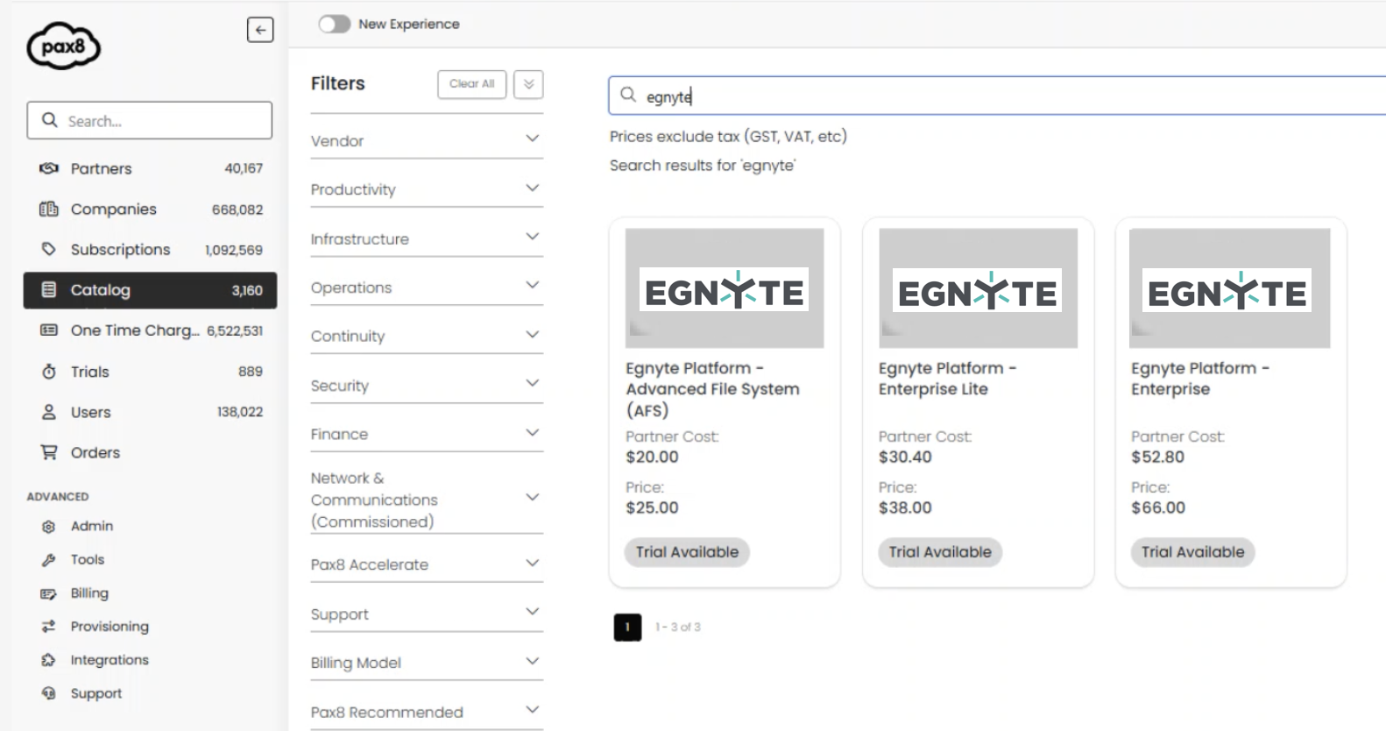
Distributor - review and select solution for automatic deployments
Problem Statement
Egnyte is starting cooperation with Pax8 who owns a marketplace for MSPs offering multiple products from a variety of vendors. To support this integration, internal systems need to be adjusted but we need to allocate time to select the best solution.
User Story
As Egnyte system I want to review and select the best solution for communication between applications so that automatic deployments can be supported.
Feature Description
• Review possible options
• Select the solution
• Coordinate with TechOPS and external teams to establish a contract
• Prepare technical document so that it is known what needs to be done
View in Productboard
APPS-13575
Link to requirements

Slide 47
Convert to PDF step
Problem Statement
As part of document-centric workflows, customers often want to create a "final" version of a document in PDF format. Today that has to be done manually and then uploaded to Egnyte.
User Story
As a user reviewing documents from an upload request, I want the system to extract key fields from documents so that I can pull that information out of Egnyte easily.
Feature Description
• Add a new PDF Conversion step to the Automated Action step in workflows
• Enable this only when the customer has the PDF Add-On
View in Productboard
CFS-66426
Missing requirements

Slide 48
Feature Entitlements Q2 2025 Grouping
Feature Entitlements Q2 2025 Grouping
View in Productboard
APPS-13455
Missing requirements

Slide 49
Server-side MixPanel events
As a Product Manager, I want to capture all events that make a call to CFS API to be captured in MixPanel; so that we ensure that all important events are tracked and sent to SFDC.
Requirements Link:https://egnyte.atlassian.net/wiki/x/CADnXg
View in Productboard
APPS-13645
Link to requirements

Slide 50
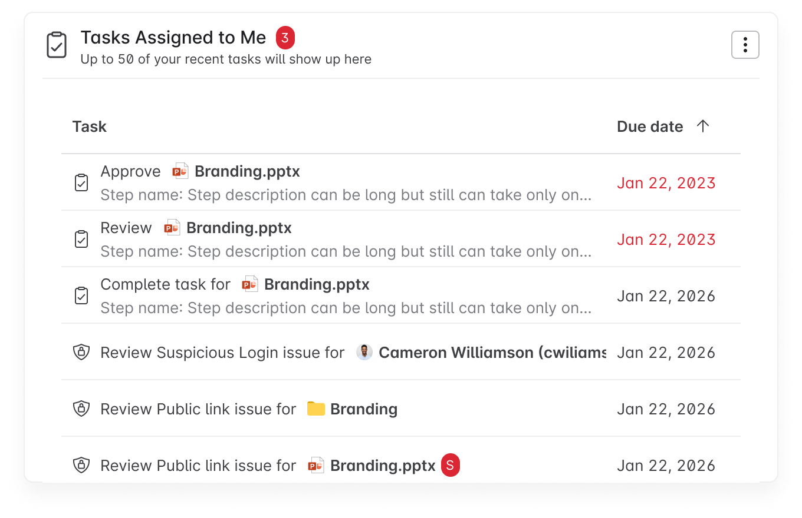
Home Page Widget for Pending Tasks
Problem Statement
Egnyte offers many types of "tasks" that can be assigned to users, but there is no consolidated place where a user can see their assigned tasks.
User Story
As a user, I want see my assigned tasks on the home page, so that I can complete my tasks on time.
Feature Description
• New widget on home page showing assigned tasks
• First iteration will include workflow tasks and assigned S&G issues
• Clicking a task will open it in the associated app
View in Productboard
CFS-63574
Missing requirements

Slide 51
Event-based updates for Pending Tasks
The description is empty.
View in Productboard
No Jira Link
Missing requirements

Slide 52
Scanning improvements
The description is empty.
View in Productboard
EMT-13611
Missing requirements

Slide 53
Async MA Client
The description is empty.
View in Productboard
EMT-13743
Missing requirements

Slide 54
[AEC] Deltek Vantagepoint Connector
When a project is created in Deltek vantagepoint, I would like a project folder to automatically be created in Egnyte.
View in Productboard
EMT-13768
Link to requirements

Slide 55
Restricting CC and other scans on migration sources
The description is empty.
View in Productboard
DEL-44953
Missing requirements

Slide 56
[Agent] [AEC] Codebooks Agent for AEC
Problem:
Users in the AEC industry require to follow regulations and standards during the design / construction / maintenance of structures and these are stipulated as building codes. These building codes are extremely long, detailed and complex, can vary by local jurisdictions and can change from year to year. Due to these factors, users often face the challenge of finding the right code information pertaining to a project, and using that information to validate project specifications, submittals and other project docs.
Use-Cases:
1. As a project engineer / field engineer, I want to easily get answers to regulatory questions, such ashow many ADA accessible parking spots do I need if my parking lot has 100 total parking spaces?
2. As a project coordinator, I want to easily validate a spec against regulations/codes- validate this stairwell design for fire safety regulation compliance
Description:
We will create a specialized agent, the code books agent, which the admin can configure to read one or more code books at a specific location on their Egnyte domain. Once configured, users can ask questions against the code book agent from the WebUI or desktop
View in Productboard
No Jira Link
Link to requirements

Slide 57
Egnyte Cloud Agent - Phase 3
CMM/S&G Integration - Phase 3
As part of phase 1, 2 points covered
• CMM Agent Installer should be able to register in S&G Env
• Once installed, it should reflect meta data of customer machine on CMM UI
• Permissions and local users/groups should also be reflected
• Migration should be allowed for this source.
• Remediation
• DPC
• AD onnectore
As part of phase 3
• Custom migration
• Event driven
• Delta snapshot
View in Productboard
EMT-12573
Link to requirements

Slide 58
[Supportability] 1 Modify Action item for Download Events in Audit Reports
https://jira.egnyte-it.com/browse/PM-1800
We need to enhance the level of detail in the event descriptions within the Audit Report.
For instance, when the following action occurs:
Download File specifically for Desktop App
They are all currently logged as "Download" events in the report. Toimprove clarity and accuracy, each of these actions should be capturedand labeled distinctly with separate descriptions.
EG.
Metadata (Should be a more detailed explanation)
offline sync
Manual download
View in Productboard
No Jira Link
Missing requirements

Slide 59
[Supportability] 2 A feature or button to clear permissions for Admins on CFS
https://jira.egnyte-it.com/browse/PM-1614
Feature Request:To have a button or feature to clearpermissions for folders only for Admins. We get a lot of request toclear folder permissions.
The only work around is to move the folder (apply destinationpermission) to a new folder location without any permissions and thenmove it. Then reset the user permissions accordingly. Imagine doing thismassive amounts of top level folders.
View in Productboard
No Jira Link
Missing requirements

Slide 60
[Supportability] 4 Search in the Settings page of the WebUI
https://jira.egnyte-it.com/browse/PM-1609
We have numerous settings and controls now andit's getting harder to find the settings that you are looking for. Evenour folks internally can no longer remember exactly where a setting is.
View in Productboard
No Jira Link
Missing requirements

Slide 61
Validator changes for UAEPersonalNumber
Context:We have implemented check digit algorithm excluding initial country code i.e. 784. But recently there is an update on source also about that now check digit calculated by including initial 3 digits(which is in this case)
Improvement required: Check digit need to look for both ways - excluding initial 3 digit and including 3 digit
Slack :https://egnyte.slack.com/archives/GSJTRDHV1/p1747401417693639
View in Productboard
DEL-45626
Missing requirements

Slide 62
[Supportability] 3 Bulk Device Management Top Priority
https://jira.egnyte-it.com/browse/PM-1607
The request is to include in the user interface of the "Devices" tab on CFS the ability to bulk update/manage devices. Domains with thousands of devices have issues with mass management such as
• device removal
• remote wiping
• deauthorizing
This case also addresses managing of active devices in bulk, not just idle/stale machines. So if I wanted to removed 100 active DAs, I should be capable of doing that rather then going into each device and removing it manually.This is really needed for ransomware-related cases.
Note:This case also addresses managing of active devices in bulk, not just idle/stale machines. So if I wanted to removed 100 active DAs, I should be capable of doing that rather then going into each device and removing it manually
View in Productboard
No Jira Link
Missing requirements

Slide 63
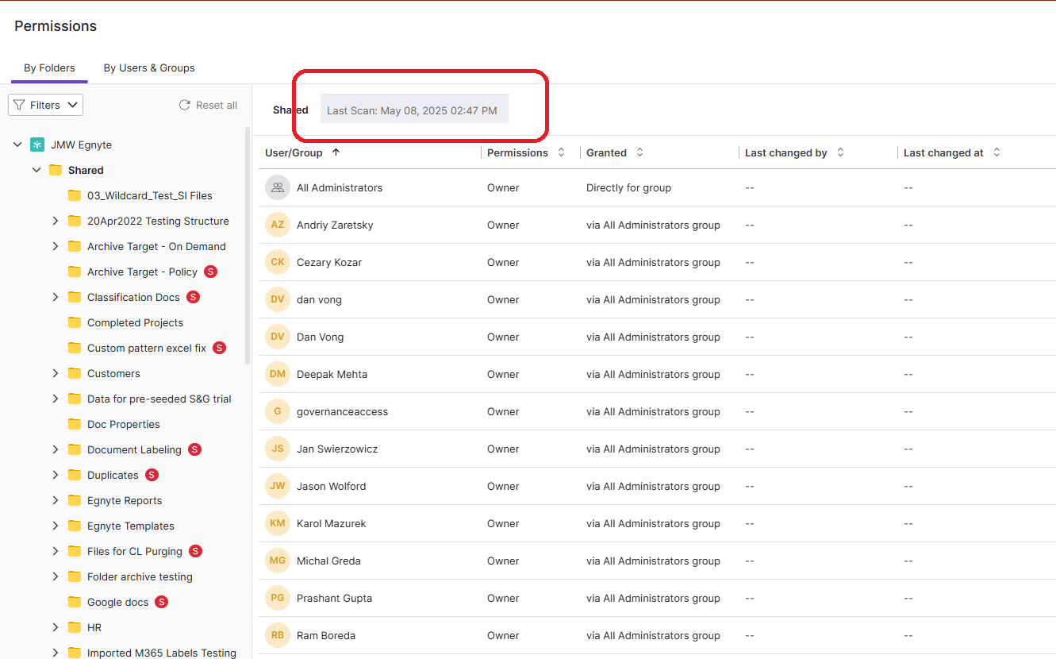
Add last completed scan time to Permissions View
Problem Statement
The S&G Permissions View syncs with CFS via regular scans. However, customers don't have visibility into when the most recent scan was completed, so they can be confused when the permissions between S&G and CFS don't match
User Story
As an admin, I would like visibility into when the Permissions View in S&G was most recently updated
Feature Description
• Provide information in the Permissions View on the last completed scan time
• This should be similar to the 'last scan' time that is shown in the content lifecycle view
View in Productboard
DEL-44649
Link to requirements

Slide 64
Augment AEC Add-on Value

Slide 65
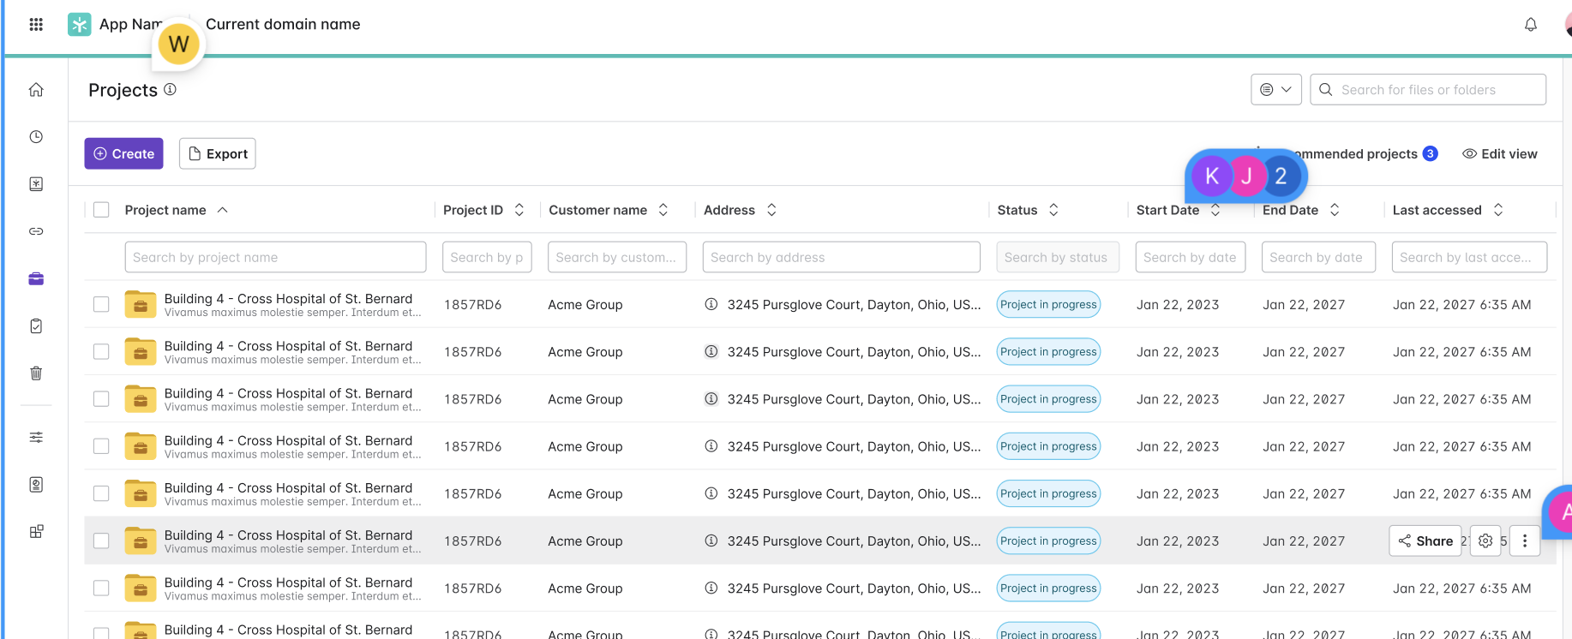
[AEC] Project Center
Problem Statement
Adoption of project folders in Egnyte is growing, just not as quickly as we had hoped. One area in which Egnyte is lacking is a need for better visibility into project folders. Customers need to be able to quickly and easily get an overview of their projects to understand things like “which projects are in progress” and “which projects are in California?”. A dedicated page/section where users can find all information related to their projects will satisfy this need.
User Story
As a user, I want to view a list of all project folders in my domain, so that I can get an overview of the projects to which I have access.
Feature Description
• Possibility to search, sort and filter project list using project metadata,
• Possibility to create a new project from the project center context
• Possibility to review project recommendations.
View in Productboard
CFS-64852
Link to requirements

Slide 66
[AEC] Native ACC Integration 1-way
Build a direct integration between Egnyte and Autodesk Construction Cloud (ACC) allowing users to sync files 1-way from ACC to Egnyte
Requirements -https://egnyte.atlassian.net/wiki/spaces/AEC/pages/746651753/ACC+Integration
Figma -https://www.figma.com/design/LlzP9CPnCoI44cAH0oKlPU/Egnyte-to-ACC-bi-directional-connection-%5BUX-3132%5D?node-id=201-376&node-type=canvas&t=3IHBOcnMUsa8sDuO-0
View in Productboard
DEL-40646
Link to requirements

Slide 67
[AEC] Team Management Enhancements
Problem Statement
Several customers participated in the early access program to test the “Team Management” feature that was rolled out for project folders & document rooms. The intent of this feature is to improve permissions management at the project/doc room level by delegating controls that have typically been saved for IT admins, to the respective project/doc room manager. Below are user stories for each piece of feedback we received in the LA period. These items should be addressed before rolling out the feature GA.
User Story
As an Admin or Power User with at least full access to the project, I want to open team management view in the folders view when I open from subfolder
Feature Description
• Manage Project Team - available for full permission users
• Team management view in the folders view when I open from subfolder
• Opening group members view will have an additional option of addind/removing group members.
View in Productboard
CFS-67272
Link to requirements

Slide 68
LS Mid Market Capabilities

Slide 69
Drafts Creation & Management
Problem Statement
Currently, our system only allows us to assign the Controlled Document ID after the document is completed or during the process of making the document effective or importing it into the application. However, some customers have expressed the need for reserving the document ID while the document draft is still being worked on. This would allow them to assign the reserved document ID once the document is approved and ready to be made effective.
User Story
As an authorized Controlled Document Management app admin or Egnyte domain admin or Category Manager
I want the ability to reserve a Controlled Document ID even before the controlled document is created and approved
So that I can use the reserved ID while making a document effective
Feature Description
This feature will allow the Category Manager and Admin users to reserve the Controlled Doc ID without making the document effective/future effective. Later, the user can use the reserved document ID when the document is ready to be made effective or imported into the Controlled Docs app.
View in Productboard
LS-4151
Link to requirements

Slide 70
Optional Effective End Date
Problem Statement:
Some forms of Controlled documents, such as validation Documents, brochures, and clinical trial protocols, do not have set expiration or end dates. Customers prefer not to have end dates for these types of documents.
User Story:
As an authorized Controlled Document Management app admin, Egnyte domain admin or Category Manager
I want to be able to set the Effective until date to optional for a specific subcategory
So that the users can leave the Effective until date blank while making documents effective/future effective for the selected subcategory
Feature Description
• The admin users should have a setting to set the “Effective until” date optional for a specific subcategory. When available, the users can mark the Effective until date optional while making the documents effective/future effective.
View in Productboard
LS-4155
Link to requirements

Slide 71
Support for CAPAs, Deviations, and Event Data
Problem Statement
Our Controlled Document Management application lacks features for managing deviations, CAPA (Corrective and Preventive Actions), and audits. Some potential customers have declined interest in using our app due to the existing gap in our system, and existing customers face challenges in efficiently managing these quality processes within Egnyte. This feature will unblock existing customers and allow us to engage in sales activities much more competitively.
User Story
As a member of my company's Quality team, I want to manage CAPAs, deviations, and audits using Egnyte's Controlled Docs application.
Feature Description
This feature allows Controlled Docs customers to manage deviations, CAPAs, and audits in Controlled Docs by enabling the creation of custom categories with configurable document statuses.
View in Productboard
LS-4286
Link to requirements

Slide 72
Permissions Management

Slide 73
Data Owner - Scheduled Permission Reviews
Admins and Data Owners need the ability to schedule periodic (monthly, quarterly, yearly) permission reviews. The following requirements need to be completed
Scheduled Permission Review Requirements:
• Approach 2 - Scheduled Reviews from Permissions Tab and SC Tab
• Provide the ability to schedule permission reviews form the Permissions tab
• Provide the ability to schedule sensitive content reviews from the Sensitive Content tab.
• No centralized Reviews window
• Allow the user to enter the review start date, end date and review duration period
• For review duration period, we should provide a dropdown with the following options:
• Weekly (7 days)
• Monthly (30 days)
• Quarterly (90 days)
• Annual (1 year)
• Custom
View in Productboard
DEL-22618
Link to requirements

Slide 74
Elevate Desktop App Capabilities

Slide 75
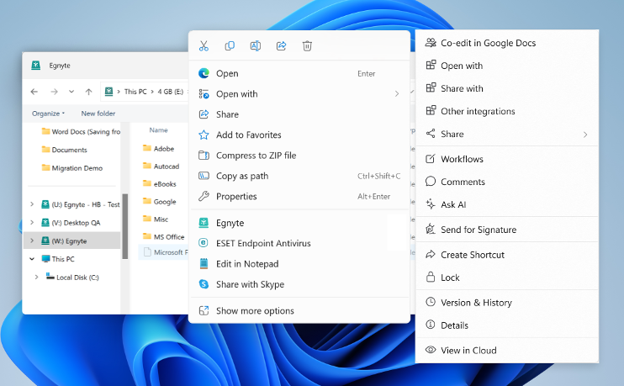
Windows 11 Context Menu Support
Problem Statement
Windows 11 moved the regular File Explorer context menu behind a "Show more options" menu and introduced a new context menu. Users cannot find the Egnyte context menu and this reduces engagement with richer functionality.
User Story
As a user I want the Egnyte context menu to be available on the top-level File Explorer context menu so that I interact with my Egnyte files directly from the desktop.
Feature Description
• Egnyte option will be exposed on the top-level File Explorer context menu
• Clicking the Egnyte option will open the Egnyte Actions "menu", providing access to a wide variety of file-level actions (link sharing, Ask AI, eSig, PDF editing, etc.)
View in Productboard
EGD-21555
Link to requirements

Slide 76
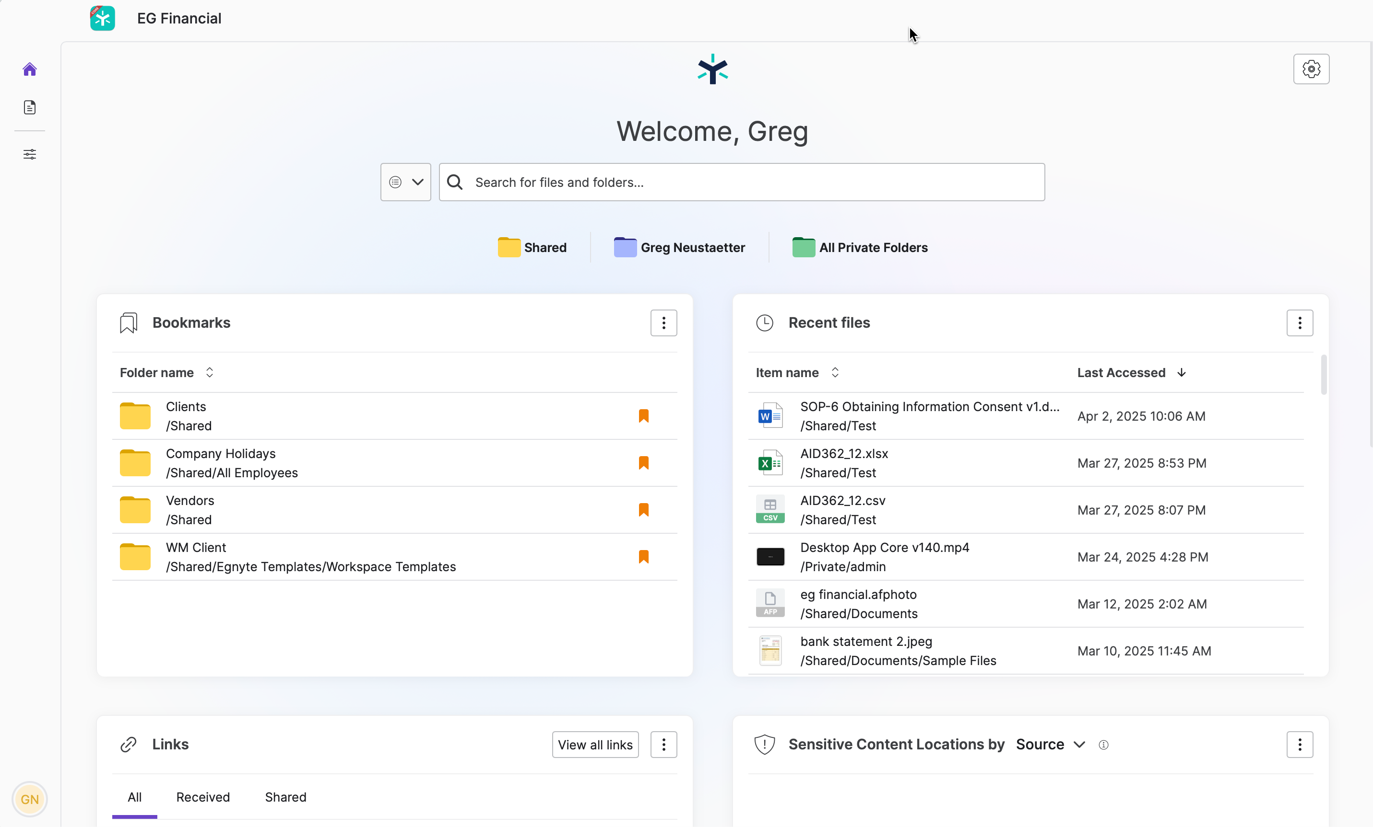
Application UI - Windows
Problem Statement
The majority of Egnyte users are Desktop Users but many new collaborative features are only available on the Web UI today. This can result in poor adoption and user experience challenges for end users.
User Story
As a desktop user, I want to access richer Egnyte functionality on the desktop, so that I don't need to open the Web UI to access them.
Feature Description
• First-class application for the Desktop App (as compared to current widget approach)
• Embed Web UI home page and search capability
View in Productboard
EGD-20540
Link to requirements

Slide 77
SCDA Mac - Beta-0 Readiness
What is the problem?
Users in media work on massive and complex files. They face a challenge of working on these files directly from the cloud
How do we solve it?
We have introduced the Adaptive Streaming and Block Caching technology in Desktop App. The Beta-0 project goal is to enable up to 5 media domains with block cache and get feedback on the following applications:
1. Adobe Premiere Pro
2. Illustrator
3. Photoshop
4. InDesign
View in Productboard
EGD-21559
Link to requirements

Slide 78
SCDA Win - Beta-2 Readiness
Problem Statement
Users in AEC and media work on massive and complex files. They face a challenge of working on these files directly from the cloud
Feature Description
We have introduced the Adaptive Streaming and Block Caching technology in Desktop App. The Beta-2 project goal is to enable up to 100 AEC domains with block cache and get feedback on the following applications:
1. AutoCAD
2. Civil 3D
3. Navis
4. Bluebeam
5. Acrobat
View in Productboard
EGD-23096
Link to requirements

Slide 79
Top Customer Requests

Slide 80
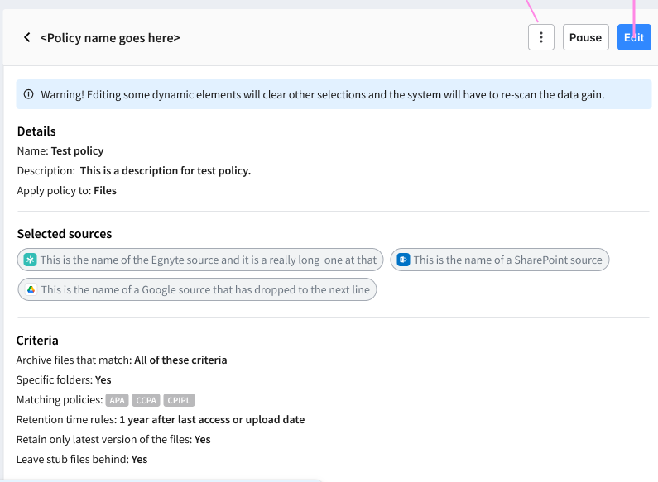
Provide ability to pause archival/deletion policies
Problem Statement
IPG has a workflow where they create an archival policy, it moves files to a 'warm archive' location in the main domain and then Storage Sync moves the files in the 'warm archive' to a external location. However, they only have the archival policy active for a few weeks every quarter.
User Story
Their current process is to delete the policies and then complete recreate them. That is a lot of work and they have requested the ability to either pause or recreate/duplicate policies so they can easily 're-enable' the policies on their current schedule.
Feature Description
• Frontend - provide pause/restart option for published policies
• Backend - use existing functionality to basically put the policy back into draft mode and unstamp the files that match the policy
View in Productboard
DEL-44353
Link to requirements

Slide 81
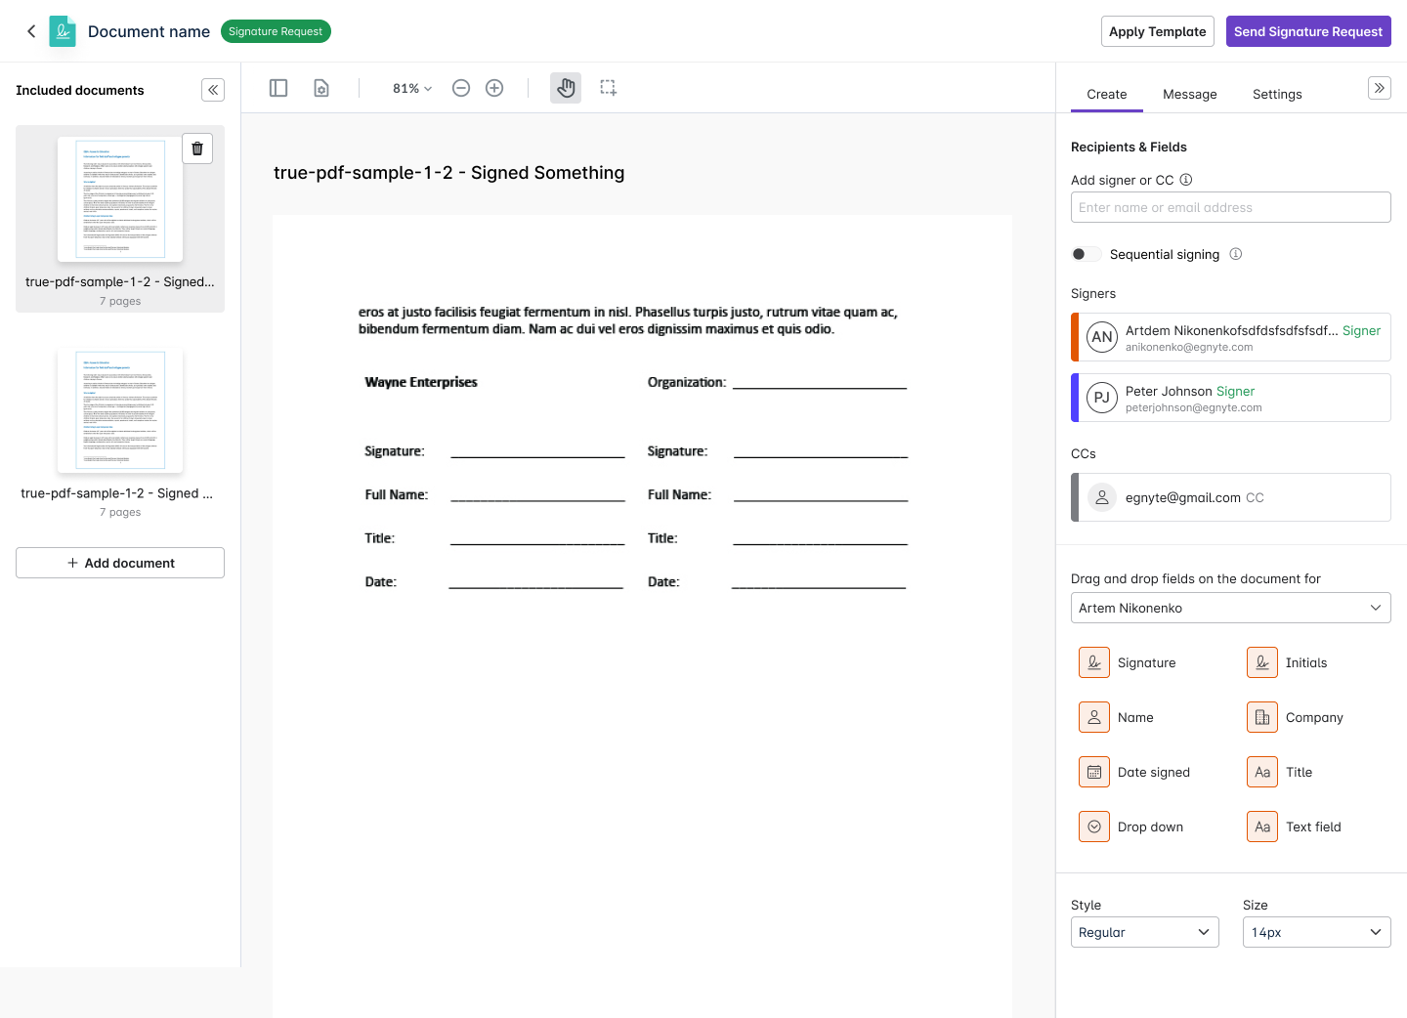
Multi-Document Envelopes
Problem Statement
With the current eSignature workflow, a user can send only one document per signature request. If a user has to send multiple documents, they have to send as many signature requests or merge the documents using PDF editing capabilities, which is inefficient.
User Story
As a signature requestor, I want to send multiple documents for signature in a single request so that I can get all of the signatures at once.
Feature Description
• Add multiple documents to a signature request
• Recipients see a consolidated set of the documents and sign them
• A single signed PDF is generated at the end of the process
View in Productboard
CFS-65375
Link to requirements

Slide 82
Bulk send eSignature requests
Problem Statement
Users who need to send a document for signature to a large number of people have to create separate signature requests for each recipient. This is inefficient and causes people to use other services for bulk requests.
User Story
As a sender of signature requests, I want to bulk send requests to save time.
Feature Description
• Use a template to send signature requests to a large number of recipients.
• The user needs to upload a CSV file that will contain emails in a column that is headed by that role. Each row will be considered as a separate request. The system will read the file and start sending signature requests.
View in Productboard
CFS-67745
Link to requirements

Slide 83
[Customer Ask] Inherit folder options to sub-folders (IPG, T&P + 7)
Problem
Today, when the folder options are changed, they do not get inherited consistently to the sub-folder tree.
• The setting that controls folder update notification gets inherited to sub-folders until it finds the folder with a manually updated option.
• The setting that controls the sharing gets inherited to sub-folders until it finds the folder with a manually updated option.
• The setting that controls who can delete/move the folder does not get inherited at all.
• Copy/move folder retains the folder options as per the source location.
User Story:
As an authorised user, I want to have folder options propagated throughout the folder tree so that I can have the same options selected on all the sub-folder trees.
Description:
We need to do the following
• We need to have inheritance applicable for the setting that controls who can delete/move the folder.
• When the user makes any change to the folder options - sharing control and/or move/delete control and/or folder update notification control - the system should evaluate if there are any manual overrides within the folder tree and if any provide the user with an option to choose whether to disregard manually overridden values.
• If the user selects to disregard the manually overridden values, then the change will be propagated throughout the folder tree, ignoring any overrides.
• If the user selects not to disregard the manually overridden values, then the change will be propagated only until the 1st manual override is found. It is the same as what we have for sharing setting updates today.
• When the user copies/moves a folder, the folder options should get inherited from destination folder where the folder is copied/moved.
• We can provide an option for the user to decide if they want to apply folder options as per destination folder (default) or source folder.
• If the user choose the default option to apply folder options as per destination folder, the folder options will get inherited fron the destination folder where the folder is being copied/moved.
• if the user chooses to apply folder options as per the source folder, the folder options will get copied over as it happens today.
View in Productboard
CFS-64734
Link to requirements

Slide 84
[Customer Ask] Group improvements (S&L, Norr)
Problem Statement
Group management that we propose is not granular enough. Either power users are not allowed to manage groups at all, or they both can manage and create groups. Customers are asking to create an in-between role that allows for group management but does not allow group creation
User Story
As an admin, I want to give users a possibility to manage groups but prevent them from creating groups on their own.
Feature Description
• Create a role PUs Group Ownership, without allowing them to create groups on their own
• Possibility to add a group description
• Enhanced group exporting and importing - indicating group owners
View in Productboard
CFS-67268
Link to requirements

Slide 85
[Customer Ask] Scheduled report enhancements (Sequoia)
Problem Statement
Currently, only admins are allowed to create scheduled reports. This is troublesome for some of the customers, since the admins are overwhelmed with requests. Additionally, scheduled reports land in a fixed folder, to which not all customers feel comfortable sharing broadly. Having a possibility to select a folder where the scheduled report would land addresses this problem.
User Story
As an admin, I want to give power users a possibility to run scheduled reports and choose custom location for storage.
Feature Description
• Auto-archival of scheduled reports
• Custom location of scheduled reports
• Saved and Scheduled queries for power users
View in Productboard
CFS-67854
Link to requirements

Slide 86
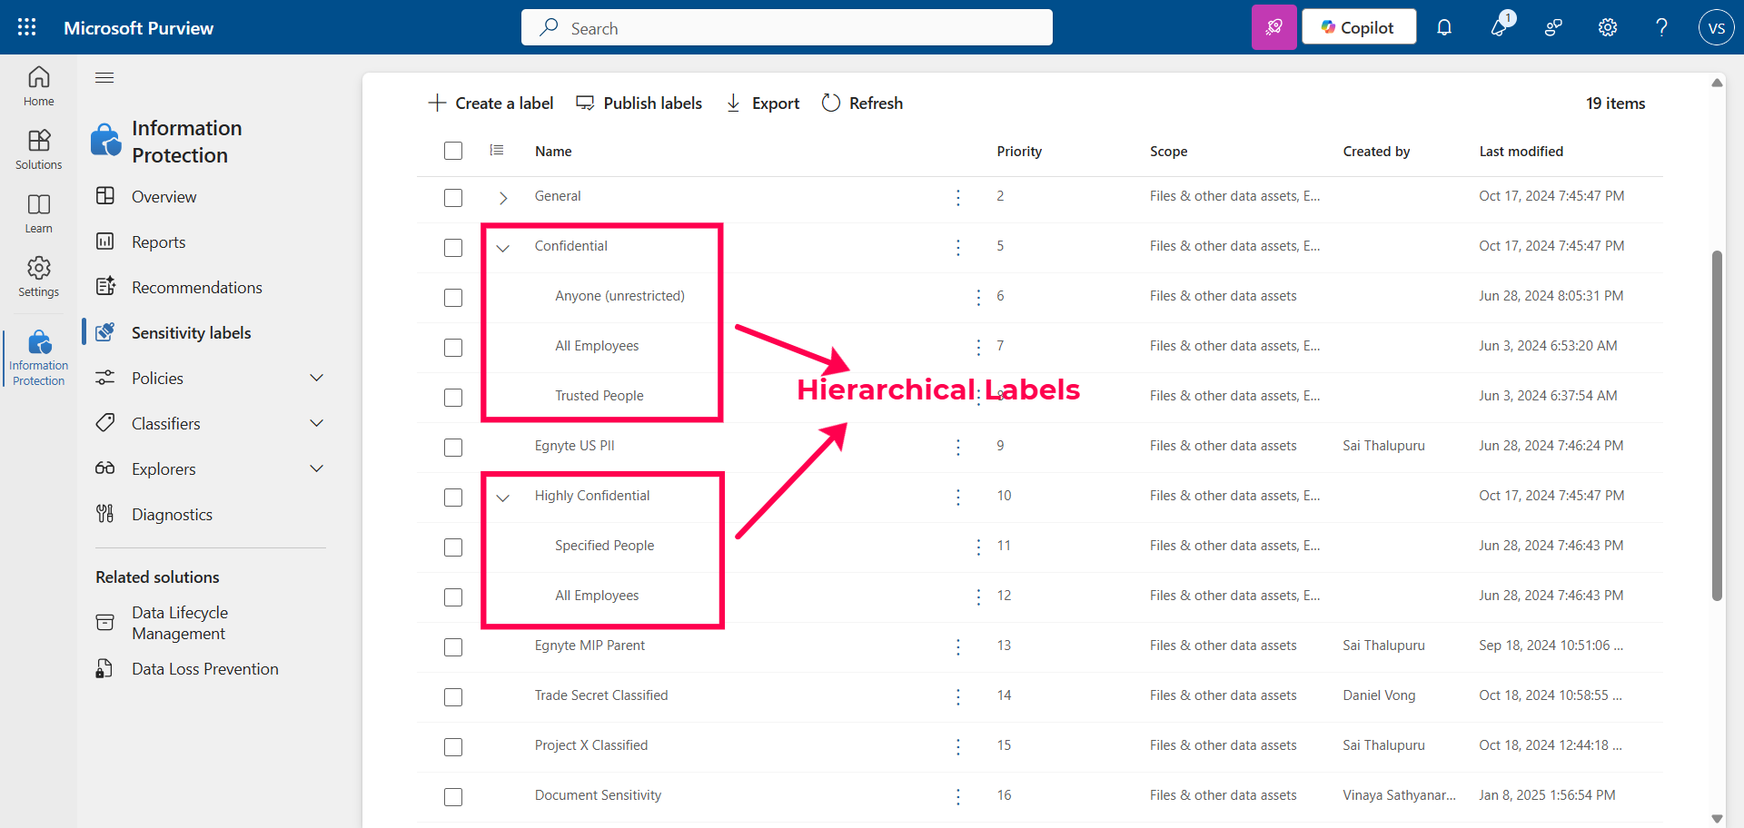
Purview labeling - Support for hierarchical labels
Problem Statement
Microsoft Purview labels can be configured with a hierarchy. Egnyte does not currently support importing hierarchical Purview-labels. This impacts customers who have already configured hierarchical labels. This hierarchy is typically configured by administrators in the Microsoft Purview
User Story
As a Security Administrator, I want to apply a Purview label from a hierarchy on a document so that I can label sensitive content correctly.
Feature Description
• Import hierarchical labels from Purview - both parent and child labels shall be imported and made available for mapping in Egnyte
View in Productboard
DEL-44656
Link to requirements

Slide 87
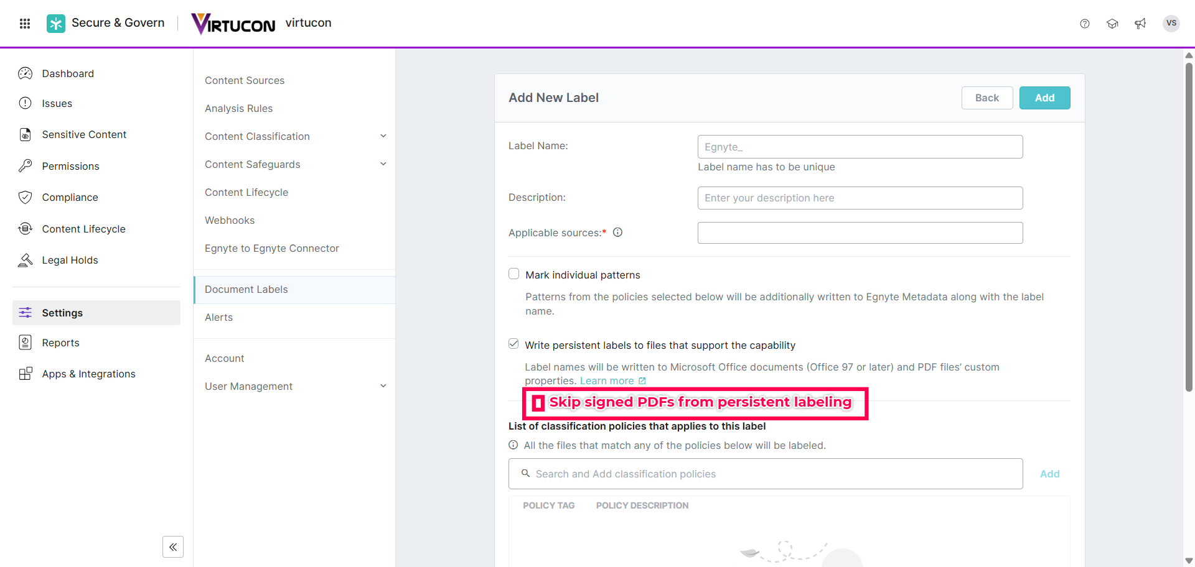
Skip signed PDFs from persistent document labeling
Problem Statement
An Egnyte Document Label when stamped as a persistent label on a signed PDF invalidates signatures on the signed PDF. This results in poor user experience and loss of user productivity as a user is required to constantly restore a previous version of the PDF before applying a signature.
User Story
As a business user I require signed PDFs to not be signature invalidated so that the integrity of the signed PDF is maintained.
Feature Description
• The Egnyte Document Label stamping process shall be enhanced to skip signed PDFs from further labeling actions
• This enhancement shall consider PDFs signed through various signing mechanisms - for example, Adobe Digital ID, Digital Signature, etc.
View in Productboard
DEL-43523
Link to requirements

Slide 88
Backup to S3 and Wasabi
What is the problem?
MSP and channel partners want to create a 2nd copy of Egnyte data on S3 or Wasabi storage. This is in order to meet their compliance needs.
How do we solve it?
Make External Replication available to MSP's and partners. Have a simplified UI workflow to enable replication
View in Productboard
DEL-45080
Link to requirements

Slide 89
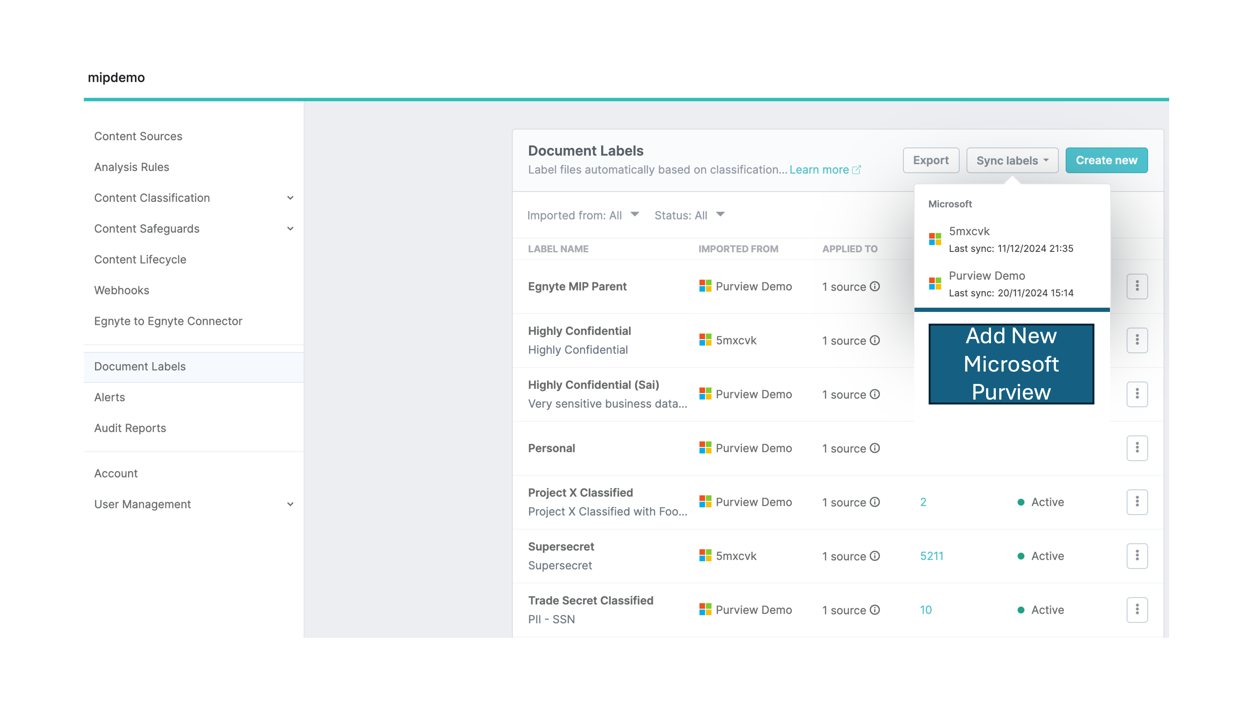
Purview labeling - Decouple labels permissions from classify and govern permissions
Problem Statement
Currently on a Microsoft content source, permissions for labels are tightly coupled with permissions for classify and govern. This presents a problem for customers who require labeling only but have to authorize permissions into their Microsoft environment for classify and govern as well.
User Story
As a business user I require decoupled permissions scope for labels and classify and govern so that I authorize only the level of permissions required into my Microsoft environment.
Feature Description
• Create a new app scope for Purview label permissions only
• Remove Purview label permissions from the current classify and govern app scope
View in Productboard
DEL-43506
Link to requirements

Slide 90
CMMC Compliance

Slide 91
*.egnytegov.com domains support for SS devices
Currently SS devices does not take *.egnytegov.com as domains as its hardcoded to *.egnyte.com domains only.
There is strong business need to support fedRAMP supported domains as more customers are opting for it and SS is the only device which is currently supported on public cloud from hybrid appliances.
View in Productboard
TRB-8299
Missing requirements

Slide 92
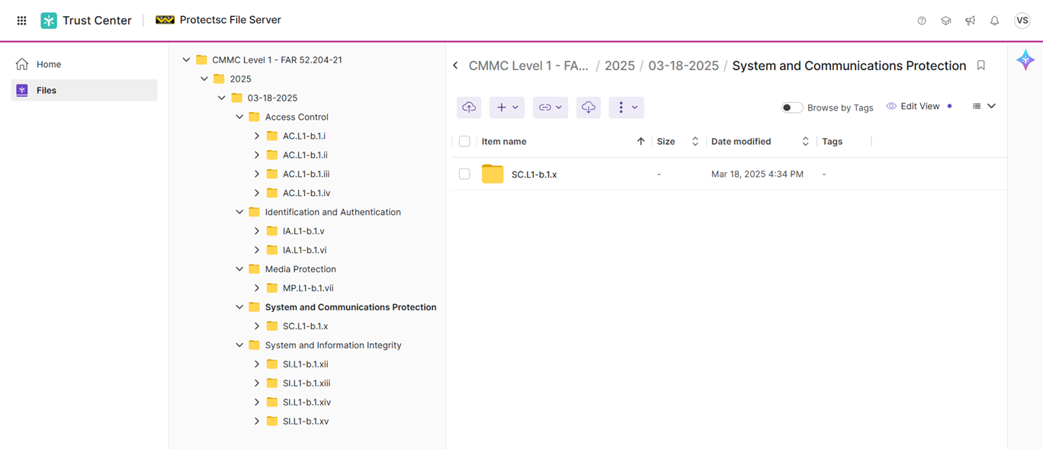
Trust Center for CMMC Level 1
Problem Statement
CMMC Level 1 is a key compliance mandate for DoD contractors and sub-contractors. Proving CMMC Level 1 compliance ensures that DoD contractors and sub-contractors can participate in DoD RFPs. Compliance Managers are required to collect evidence (or artifacts) for all CMMC Level 1 controls. This is a time and resource intensive effort often leading to human errors, guess work, and rework. Compliance Managers greatly benefit if they had a mechanism to collect such evidence automatically and on a recurring schedule (to prove continuous compliance).
User Story
As a Compliance Manager, I want to collect evidence for CMMC Level 1 controls, so that I can be CMMC audit-ready.
Feature Description
This feature includes:
• Content pack for CMMC Level 1 (Control Number, Control Family, and Control Text)
• Mapping CMMC Level 1 controls to Egnyte capabilities
• Collecting evidence for CMMC Level 1 controls
• Integration into Trust Center landing page
View in Productboard
DEL-43244
Link to requirements

Slide 93
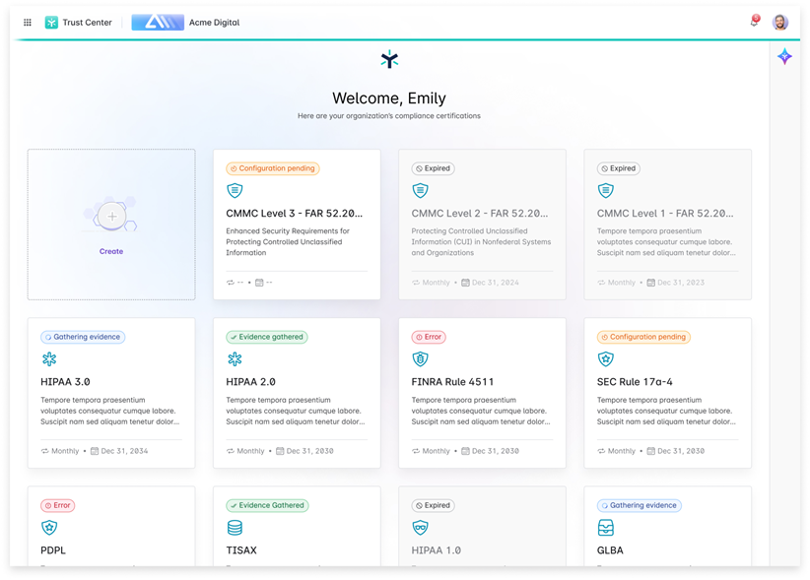
Trust Center for CMMC Level 2
Problem Statement
CMMC Level 2 is a key compliance mandate for DoD contractors and sub-contractors. Proving CMMC Level 2 compliance ensures that DoD contractors and sub-contractors can participate in DoD RFPs. Compliance Managers are required to collect evidence (or artifacts) for all CMMC Level 2 controls. This is a time and resource intensive effort often leading to human errors, guess work, and rework. Compliance Managers greatly benefit if they had a mechanism to collect such evidence automatically and on a recurring schedule (to prove continuous compliance).
User Story
As a Compliance Manager, I want to collect evidence for CMMC Level 2 controls, so that I can be CMMC audit-ready.
Feature Description
This feature includes:
• Content pack for CMMC Level 2 (Control Number, Control Family, and Control Text)
• Mapping CMMC Level 2 controls to Egnyte capabilities
• Collecting evidence for CMMC Level 2 controls
• Integration into Trust Center landing page
View in Productboard
DEL-44555
Link to requirements

Slide 94
egnytegov Support for Smart Cache
What is the problem?
CMMC customers want to deploy Smart Cache in an egnytegov.com domain
How do we solve it?
We need to ensure Smart Cache can register with a *.egnytegov.com domain and is on par in terms of functionality and performance with a Smart Cache on egnyte.com domain
View in Productboard
No Jira Link
Missing requirements

Slide 95
Product-Led Growth

Slide 96
Recommendation Engine Model Development
Break into the Model Versions & Phases
What did we do in Q2?
What are we working on in Q3?
Break it out and focus on Q4
View in Productboard
No Jira Link
Missing requirements

Slide 97
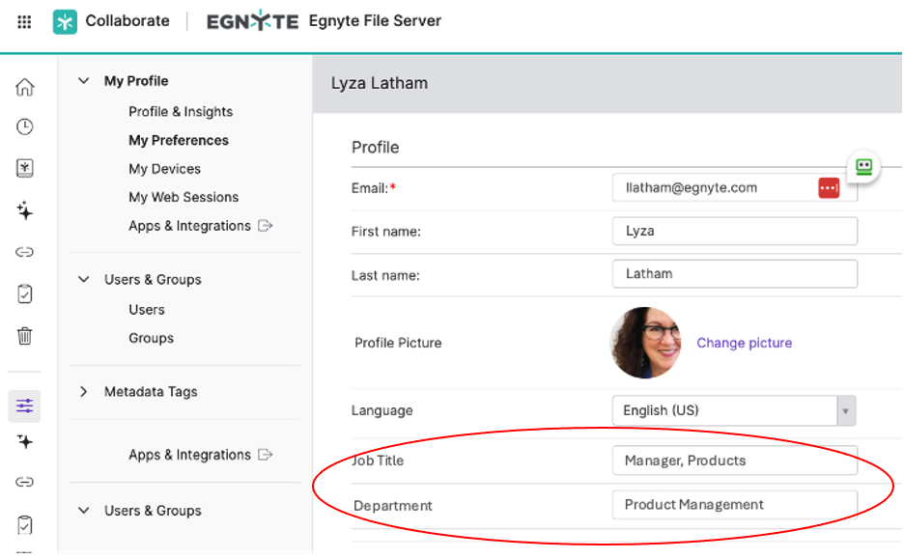
[PLG] User Enrichment: Job Roles MVP
Problem Statement
• We need to have more accurate Job Roles assigned to our users in order to deliver tailored experiences and recommendations
User Story
• As a PM, I want to understand who the users are that will most closely match the features I'm trying to promote.
• As a PM, I want to understand how different types of users adopt features on our platform.
• As a Marketing professional, I want to know how to target our users more effectively
• As a Sales professional, I want to understand how to upsell new features and generate growth revenue
Feature Description
• Capture new users' Job Roles
• Allow existing users to change and update their information on their profiles
• Implement a series of efforts to capture existing users' job roles
See Confluence:
https://egnyte.atlassian.net/wiki/spaces/IN/pages/1275134151/Capturing+Job+Function+for+All+Users
View in Productboard
GR-598
Link to requirements

Slide 98
Recommendation Engine Test Campaigns
Continue testing the Recommender against Pendo in a series of campaigns.
View in Productboard
GR-578
Missing requirements

Slide 99
Introduce Gen 4 Plans

Slide 100
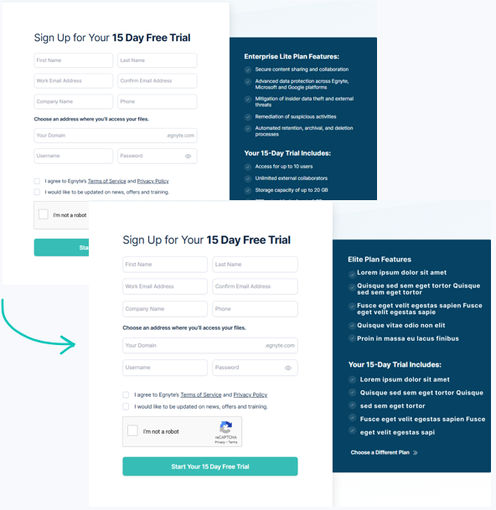
Gen 4 Launch - Trial Registration Pages
Problem:
The trial registration pages must be updated to support Gen 4 plans (Starter, Essentials, Elite). Without this, we can’t launch them as the default on the website or enable free trials.
User Story:
As a prospect, I want a straightforward and easy way to start a free trial so I can evaluate the features and benefits of Egnyte’s new plans.
Description:
Update the registration pages with the latest features and trial inclusions to provide prospects with a seamless experience and make it easier to convert them into paying customers.
View in Productboard
APPS-12215
Link to requirements

Slide 101
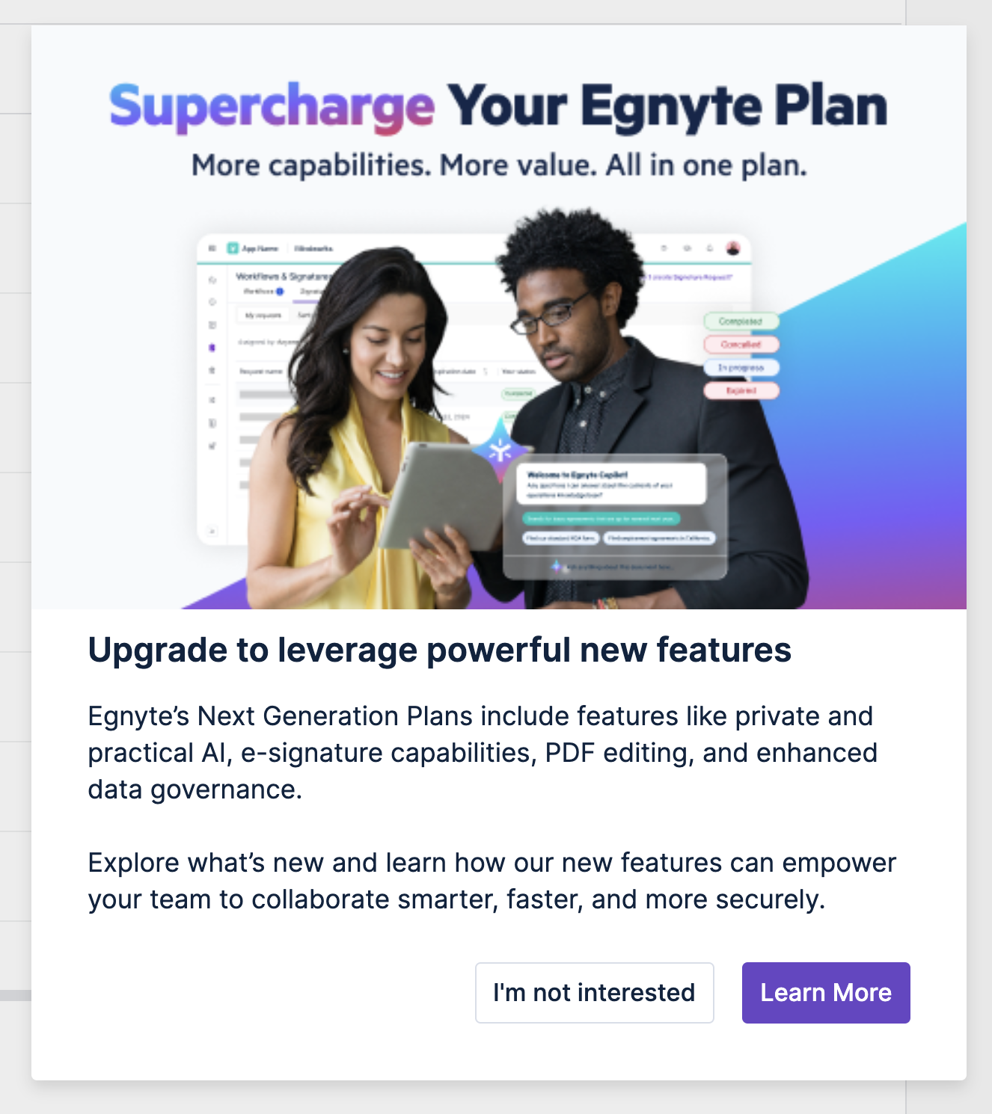
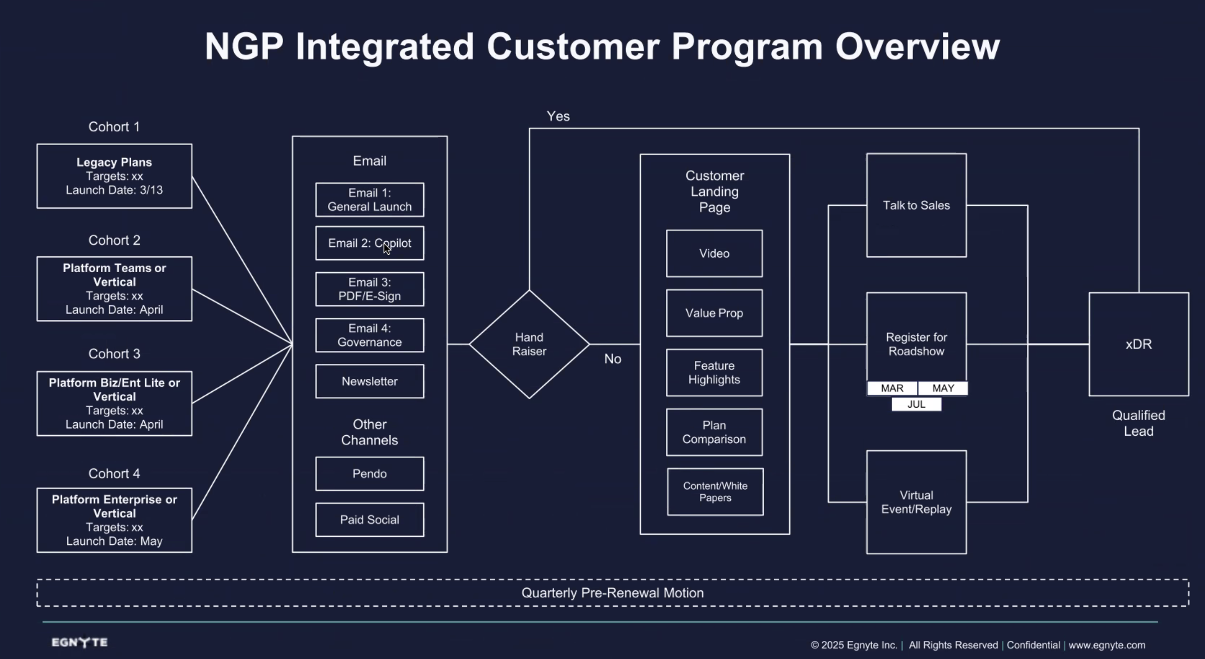
NGP Upsell from G3 and Prior
In collaboration with Marketing, we will launch a series of Pendo Upsell campaigns aligned to other marketing efforts.
View in Productboard
GR-562
Link to requirements

Slide 102
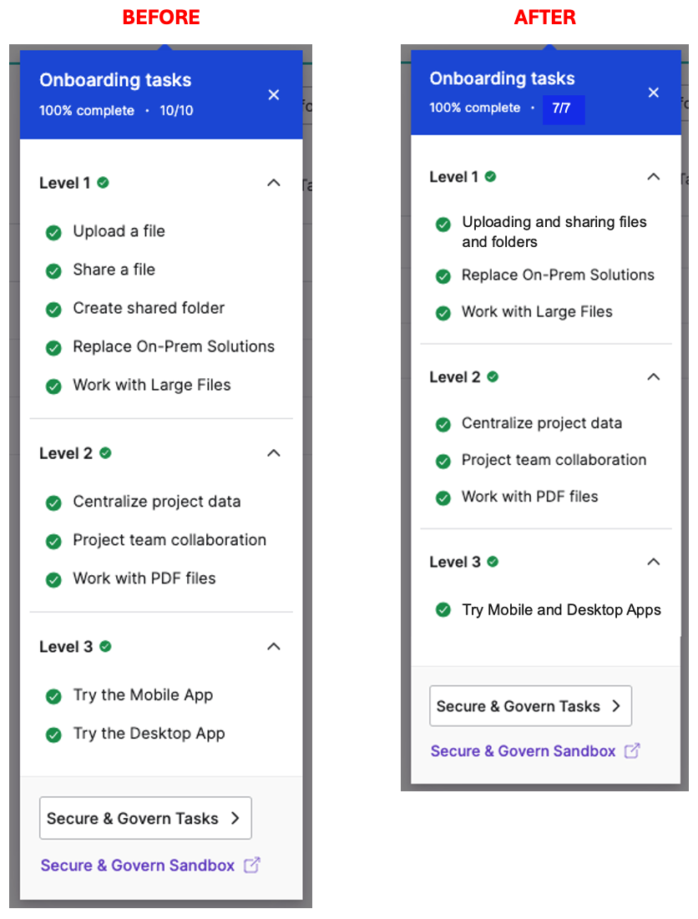
[PLG] Trial Onboarding Refinements (Milestone 4)
Includes a variety of refinements to the NGP Trial Onboarding experience.
• Various minor UI bug fixes, tooltips and alignment issues.
• Simplifying the Onboarding task list to make it more less daunting
• Consolidating the first 2-3 steps
• Consolidating "Try Desktop App and Mobile App"
• Automatically creating a Standard User in Teams/Starter so we can re-introduce the "Share Folder" step
• Animations for the Gamification Rewards
• Unlocking file/folder templates
View in Productboard
CFS-66581
Link to requirements

Slide 103
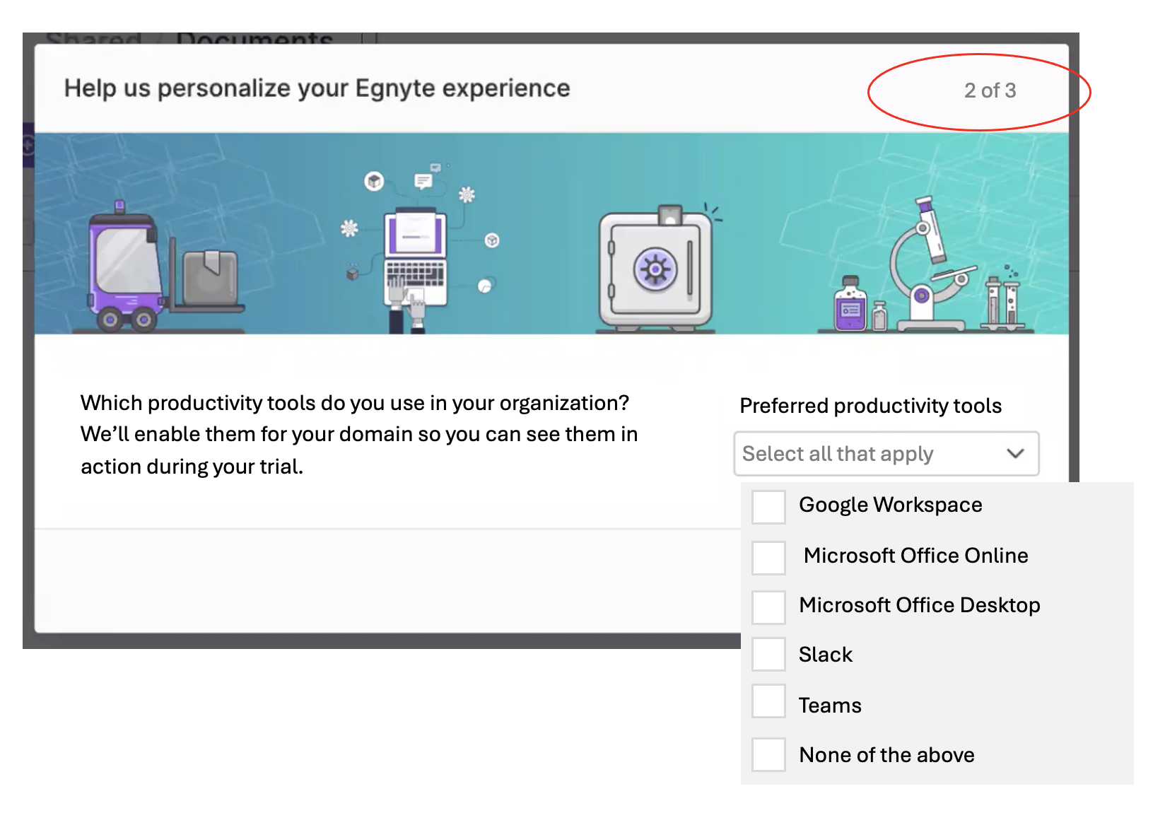
[PLG] Trial Onboarding Integrations Enablement (Milestone 3)
See [https://egnyte.atlassian.net/wiki/x/BgBEV]
• We know that domains with 3 or more Integrations are much stickier.
• As part of the Onboarding experience, we are adding a question to the Admin Survey to determine what type of productivity tools they use. We will automatically enable the appropriate integrations (Google, MS, Slack)
• We will automatically enable other Integrations from the Egnyte App Store, based on the industry specified. Many integrations can't be enabled without input from the customer, so we will only enable a handful for each.
• Starting with the 5 industries called out in the App Store, we want to include these integrations if users select any of the following:
• Architecture, Engineering or Construction
• Financial Services
• Healthcare or Life Sciences
• Legal
• Media & Entertainment
• Nice to Have: Gov, and possibly others
PINT team has completed an API for the App Store that will be used for this initiative.[https://egnyte.atlassian.net/wiki/spaces/PINT/pages/1166082078/App+Store+Configuration+API+for+Egnyte+Platform]
View in Productboard
GR-591
Link to requirements

Slide 104
[Usability] NGP UI Refresh (Phase 1)
This project involves introducing UI+visual design changes to the platform (all apps) towards distinguishing Next Gen 4 Plans from the previous ones. These changes are deemed necessary to coincide with the release of NGP4, hence the high priority.
Details can be found attached to this Epic -https://jira.egnyte-it.com/browse/UX-3393
Phase 1 includes:
• Comprehensive styling, content, and UI updates to the top/header bar (CFS)
• Updates to the main (left) navigation styling (CFS)
• Introducing brand-new styling to menu buttons (CFS)
• Comprehensive overhaul of the right-drawer menu bar, including brand-new colored icons (CFS)
View in Productboard
CFS-65726
Link to requirements

Slide 105
NGP UI Refresh S&G
Requirements for UI Refresh Alongside the Introduction of the New Generation of PlansChanges Applicable Only to Users on Domains Switched to the New Plans:
1. Refreshed top bar
1. New Egnyte logo
2. Plan name indicator (Final plan names are not yet determined, so we recommend implementing this with the ability to hide it.)
3. Background gradient in the top bar (Initially, we will implement a single gradient, with specific values provided in Figma. Ultimately, each new-generation plan should have a distinct background gradient.)
4. Branding bar: Reduced thickness from 4px to 2px. For domains without a defined custom color, we will introduce a new default color. For domains with a custom color set by the client, it should remain unchanged.
Changes Visible to All Plans:
1. Updated styling for the left navigation bar elements: larger icons (20px) and added background color for the active menu item.2. Refreshed button styles to enlarge the size of the icons to 20px3. Add Right Drawer component4. Relocation of Help Center / Egnyte University / Product Updates entry points to the right drawer.
Figma Designs:https://www.figma.com/design/AXtKz4IExGp3WfTjTZqSrN/Platform---Home-page-redesign-across-verticals?node-id=1726-35543&t=Xw9ungNWCco75ZRd-1
View in Productboard
DEL-44118
Link to requirements

Slide 106
[Usability] NGP UI Refresh (Phase 2)
This project involves introducing UI+visual design changes to the platform (all apps) towards distinguishing Next Gen 4 Plans from the previous ones. These changes are deemed necessary to coincide with the release of NGP4, hence the high priority.
Details can be found attached to this Epic -https://jira.egnyte-it.com/browse/UX-3393
Phase 2 includes:
• Comprehensive styling, content, and UI updates to the top/header bar (S&G)
• Updates to the main (left) navigation styling (S&G)
• Introducing brand-new styling to menu buttons (S&G)
• Introducing the right-drawer side panel to the UI in S&G. This is also needed for delivering contextual AI + Recommendation Engine capabilities in S&G.
View in Productboard
CFS-67266
Link to requirements

Slide 107
Trial Onboarding: Unlock File/Folder Templates
The description is empty.
View in Productboard
No Jira Link
Missing requirements

Slide 108
Workflow Enhancements

Slide 109
Optional documents
Problem Statement
There is no way to mark the document optional within the template. To complete the request, an uploader must add all the documents from the template.
User Story
As an Egnyte Domain Administrator or a power user with an assigned role, I would like to mark a specific document optional within the template So that the uploaders can complete the upload request even if that document is skipped
Feature Description
• Allow users to mark a document as optional as part of the template.
• The optional document can be skipped by an uploader and all the actions should be recorded in the audit report.
View in Productboard
CFS-67185
Link to requirements

Slide 110
Upload request instance modification from template
Problem Statement
The upload request template cannot be modified at all while creating an upload request instance. The customers would like to remove specific document(s) or mark them optional while creating a request instance.
User Story
As an Egnyte Domain user, I would like to modify the documents from a template while creating an upload request so that I can modify the existing template to request specific documents based on specific criteria.
Feature Description
• While creating an upload request instance, allow users to mark a document as optional or remove the document from a template.
• Provide a setting in the template to control the modification action while creating an upload request instance.
View in Productboard
CFS-67186
Missing requirements

Slide 111
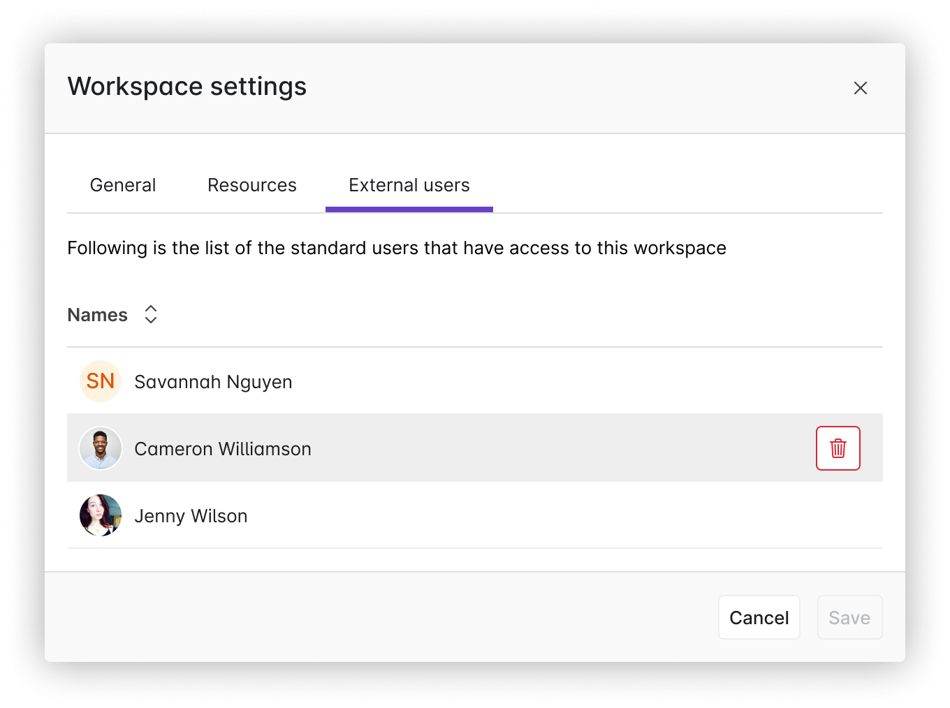
External User Management
Problem Statement
Once a Standard User is added to a workspace there is no way to remove them and they are no longer able to access Collaborate
User Story
As a user, I want to be able to remove Standard Users from a workspace, so that they can access Collaborate
Feature Description
• Provide external user management screen in Workspace Settings that shows external users and allows you to remove them
• If a Standard User is removed from a workspace they should be able to access Collaborate (unless they are associated with other Workspaces)
View in Productboard
CFS-65920
Link to requirements

Slide 112
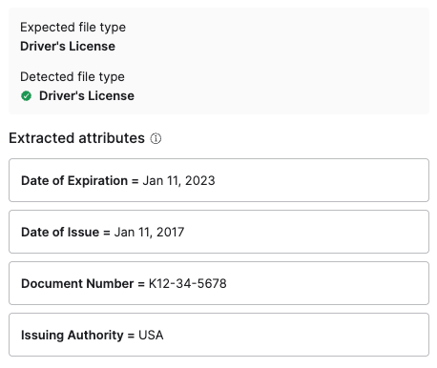
Upload request metadata extraction
Problem Statement
External users add document via upload requests, often as photos of documents, and then our customers need to review those documents and often pull out key fields and enter them into other systems. This can be challenging and time consuming.
User Story
As a user reviewing documents from an upload request, I want the system to extract key fields from documents so that I can pull that information out of Egnyte easily.
Feature Description
• Automatically extract key fields from documents submitted via an upload request
• Keep data encrypted at rest as it may be sensitive
View in Productboard
CFS-67495
Link to requirements

Slide 113
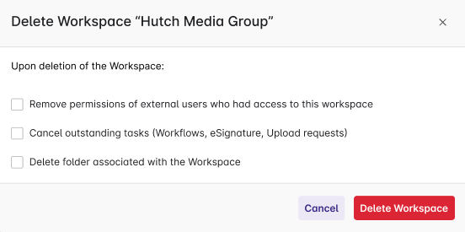
Deleting a Workspace
Problem Statement
Customers create workspaces and then realize that either they chose the wrong folder or don't want the folder to be treated as a workspace. Today there is only a way to deactivate the workspace, but not remove it.
User Story
As a user I want to delete a workspace so that the folder is treated as a normal folder in Collaborate
Feature Description
• Add new action to workspace settings to delete the workspace
• Provide options to delete the folder and to remove external access
View in Productboard
CFS-63196
Link to requirements

Slide 114
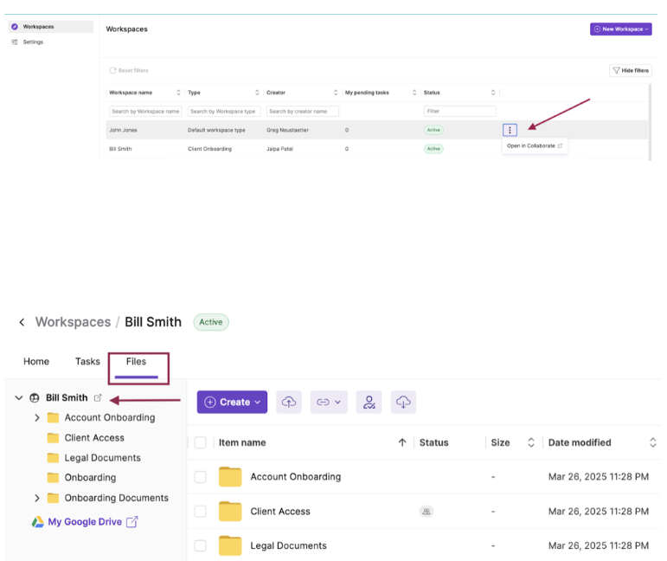
Open Workspace folder in Collaborate
Problem Statement
Users cannot easily find or navigate to collaborate folder associated with a Workspace.
User Story
As as internal user I want to quickly navigate to Collaborate folder from a Workspace I am working on so that I can interact within Collaborate easily.
Feature Description
Users will be given an option to navigate to Collaborate folder from a Workspace.
View in Productboard
CFS-66567
Link to requirements

Slide 115
Enhanced AI copilot

Slide 116
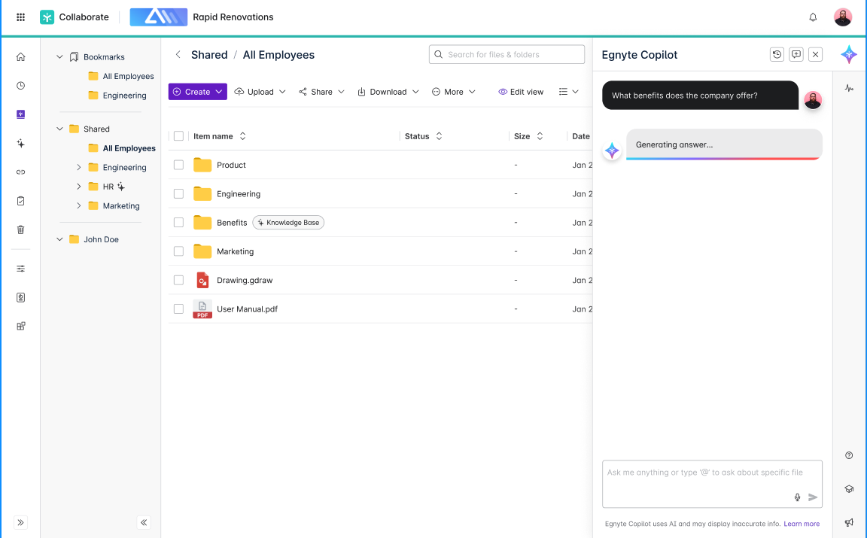
[Copilot] Improved Loaders / Streamed responses
Problem Statement
Users experience uncertainty or frustration when Co-Pilot responses take longer to generate. As we wait for the LLM to generate the complete answer & there is limited visual feedback during this period leads to a poor UX.
User Story
As a user, I want to see visual indicators (animations/loaders) and receive streamed responses while the Co-pilot generates an answer, so that I feel confident the system is working and can start consuming information faster.
Feature Description
• Introduce animated loaders and display helpful loading text during AI response generation in Copilot and Knowledge Base.
• Loaders update state every 2 seconds until streaming begins.
• When streaming starts, loaders disappear, and the response is displayed progressively.
Embedded content
View in Productboard
CFS-67395
Link to requirements

Slide 117
S&G Co-pilot - Phase 1 - Helpdesk & Blogs
This would basically be scanning through Helpdesk and Blogs to answer secuitry specific questions. Currently the helpdesk built on CFS is defunct (legacy tech). Team is trying to user vertex ai to tune for better results.
This also introduces the Co-pilot UX into S&G as an entry point.
View in Productboard
DEL-44757
Missing requirements

Slide 118
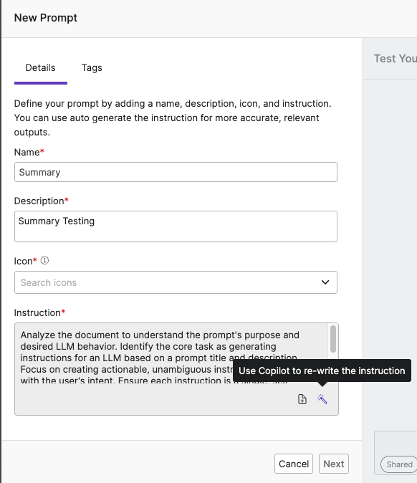
* [Copilot] Improve Prompt (Wand Icon) on Chat Input UI [Copilot, ASK, and KB]
Problem Statement
Users often struggle to craft clear and effective prompts when interacting with Copilot, ASK, and Knowledge Base. This results in suboptimal model outputs—particularly for small or multi-step queries—leading to a poor user experience and negative perception of product performance. This issue becomes especially evident during onboarding sessions and Sales demos, where non-technical users may not articulate inputs in a way that elicits the desired responses from the system.
User Story
As a user, I want the ability to automatically improve or rephrase my input using a built-in feature, so that my query is clearer, more complete, and more likely to return accurate and helpful results from the Egnyte AI products.
Feature Description
We propose introducing a“Refine Prompt”feature, represented by amagic wand iconplaced beside the user input field across Copilot, ASK, and Knowledge Base interfaces.
• When clicked, the feature sends the user’s input to a backend LLM service, which rewrites the prompt to make it more explicit, structured, and contextually rich.
• The rewritten prompt helps improve model understanding and response accuracy.
• This functionality already exists in our “Create Prompt” workflow; the aim is to extend or repurpose that flow into high-usage chat surfaces with minimal lift.
Value
• Increases prompt clarity and quality, especially for new or non-technical users
• Reduces trial-and-error for the end user
• Helps Sales and CS teams showcase the platform more effectively
• Lays the groundwork for future automated prompt rewriting.
UX designs -
View in Productboard
CFS-68088
Link to requirements

Slide 119
Shore the Core [NPS]

Slide 120
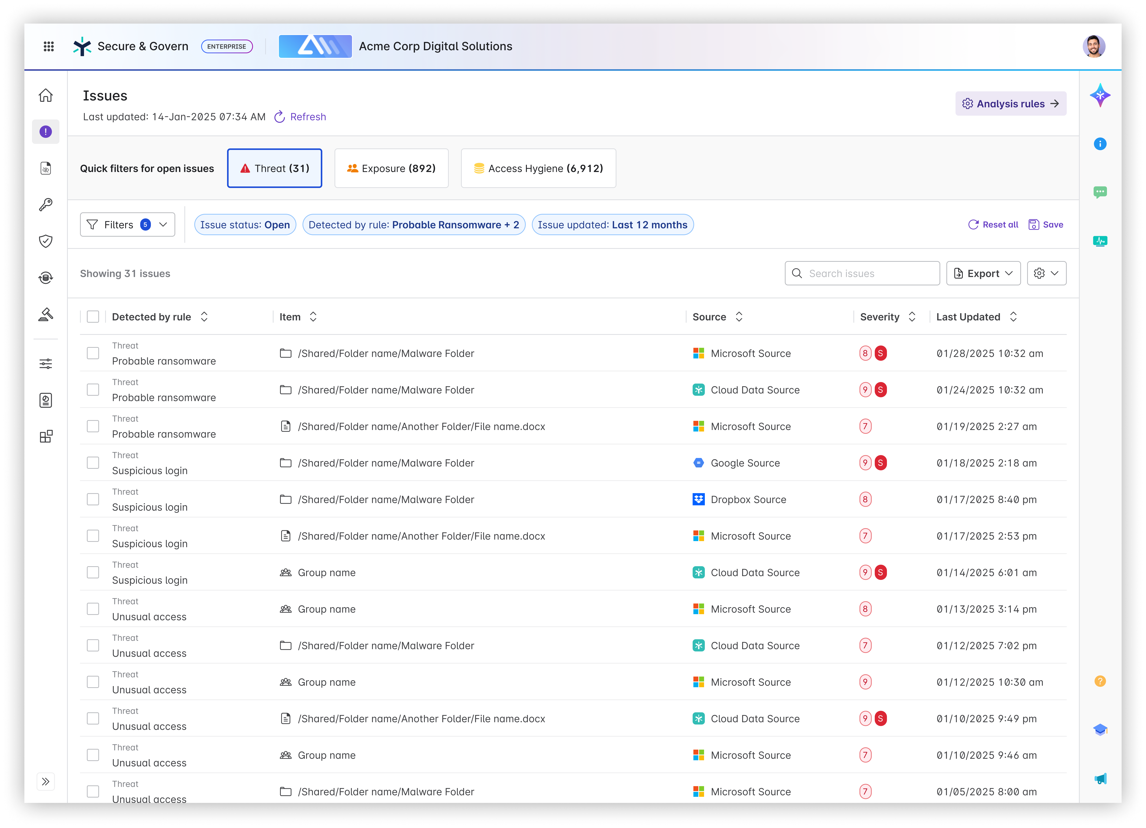
Issues - New Issue Categories
Problem Statement
Security teams are inundated with alerts - not just within Egnyte but across their security tool stack. They have limited time and people to review all alerts which can lead to true risk to the organization to be missed (alert fatigue).
User Story
As a security or IT administrator reviewing Issues, I need help determining where to focus and what is a priority.
Feature Description
Categorize existing Issue types into three categories: Exposure, Threat, and Access Hygiene. The focus will be to direct administrators towards tackling Exposure and Threat Issues first as they represent risk to the organization.
View in Productboard
DEL-42493
Link to requirements

Slide 121
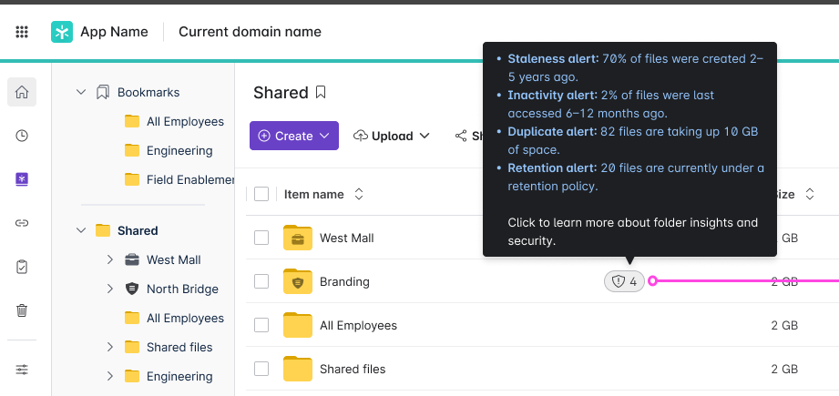
S&G Folder Insights in CFS - Phase 2
Problem StatementAfter providing visibility into the basic Content Lifecycle analytics we want to expand what S&G information we show users in CFS
User Story
As a user, I want to be able to access information about my files without needing to navigate to Secure & Govern
Feature Description:
• Create S&G Insight badge component placed in a Status column of the files list on the folder level
• Badge should show the number of S&G Insights for given folder
• Number of open issues
• number of Sensitive Content
• Percent of files older than 5 years
• Each S&G Insight needs to have a threshold, and only after exceeding this threshold Insight should be shown
Public Summary
The folder insights feature has proven to be a valuable feature to Egnyte customers, with over 30% of eligible domains utilizing the feature in the first 2 months after release, without any type of promotion at all. We want to further increase the value of this feature by both expanding the information it presents and also displaying notifications to users when certain data thresholds are crossed
View in Productboard
DEL-41981
Link to requirements

Slide 122
Delegate Issue to Data Owner
Problem Statement
Customers that heavily use Data Owners want the ability to a delegate an Issue to a Data Owner from the Issues view or automatically via Auto-Remediation rules.
User Story
As an S&G user, I want the ability to easily assign issues to the appropriate Data Owner so that they can remediate it.
View in Productboard
DEL-44433
Link to requirements

Slide 123
Enable Power Users Folder Full access to Folders they Create
In order for a power user to have S&G visibility, the power user must have Folder Full access to the individual folders to see issues and sensitive content in their S&G instance.
This feature would delegate Folder Full access to power users for any sub-folder(s) that they create where they have Folder Editor permissions in the parent folder. This would mitigate having the Egnyte Admin user needing to do it on-demand at-request by the Power User and this also empowers the Power User from a CFS perspective to be able to have folder full access to the folders and content that they are creating and populating and as such the ability to delete any unintentionally created files in the folder that they currently only have Folder Editor privileges to.
This feature would result in the following capabilities:
1. Configuration to enable Folder Full access to Folder Editors for folder editor-created folders
In Settings, Configuration - User Types & Roles - under Power User - the following configuration should be enabled -
Configuration (bolded valuesaredefault):
Option A: DelegatedFolder Full rolewhen creating a new folder – Enabled(True,False**)**
Option B: Delegated role when creating a new folder – Picklist: (Folder Full, Folder Owner, None)
2. When the Value is True or Folder Full (depending on Option A or B) for this feature in Settings/Configuration/User Types&Roles/Power User - then any new folder created by a Folder Editor will result in the permission promotion/escalation of the newly created folder for the folder editor who created the folder to Folder Full.
3. This value will be default set to True or Folder Full (depending on Option A or B) for all domains upon release, as there should be minimal impact to existing workflows since the feature upon release will only impact newly created folders and not existing folders.
View in Productboard
CFS-63434
Missing requirements

Slide 124
External Link Auto-Remediation (Milestone 3)
PLACEHOLDER
View in Productboard
DEL-44739
Missing requirements

Slide 125
Build Pax8 Distributor Program

Slide 126
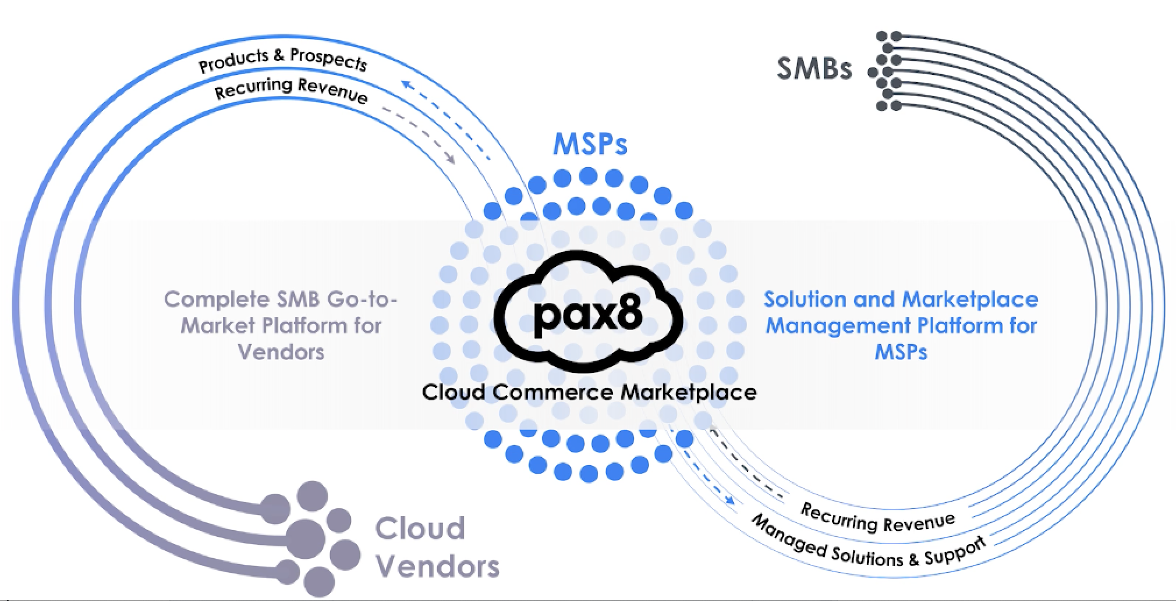
Distributor - new type of resellers
Problem Statement
Egnyte is starting cooperation with Pax8 who owns a marketplace for MSPs offering multiple products from a variety of vendors. To support this integration, internal and customer facing applications need to be adjusted.
User Story
As an Egnyte staff user I want to manage a Pax8 MSP so that Egnyte can sell products through a Distributor.
Feature Description
• Distinguish MSP partners as managed by Pax8 Distributor
• Allow Egnyte internal staff users to manage such MSPs in the Reseller dashboard
• Simplify onboarding and approval process (plan category, Pax8 planset, no CC required)
• Exclude such partners from financial processes (payments, invoicing)
• Adjust existing MSP Reseller dashboard for such partners allowing them only to:
• view and access the child domains
• manage own employees users
• go to their NFR (demo) domain
• configure Single SignOn
• access Training, Partner Toolkit, My Account
View in Productboard
APPS-12865
Link to requirements

Slide 127
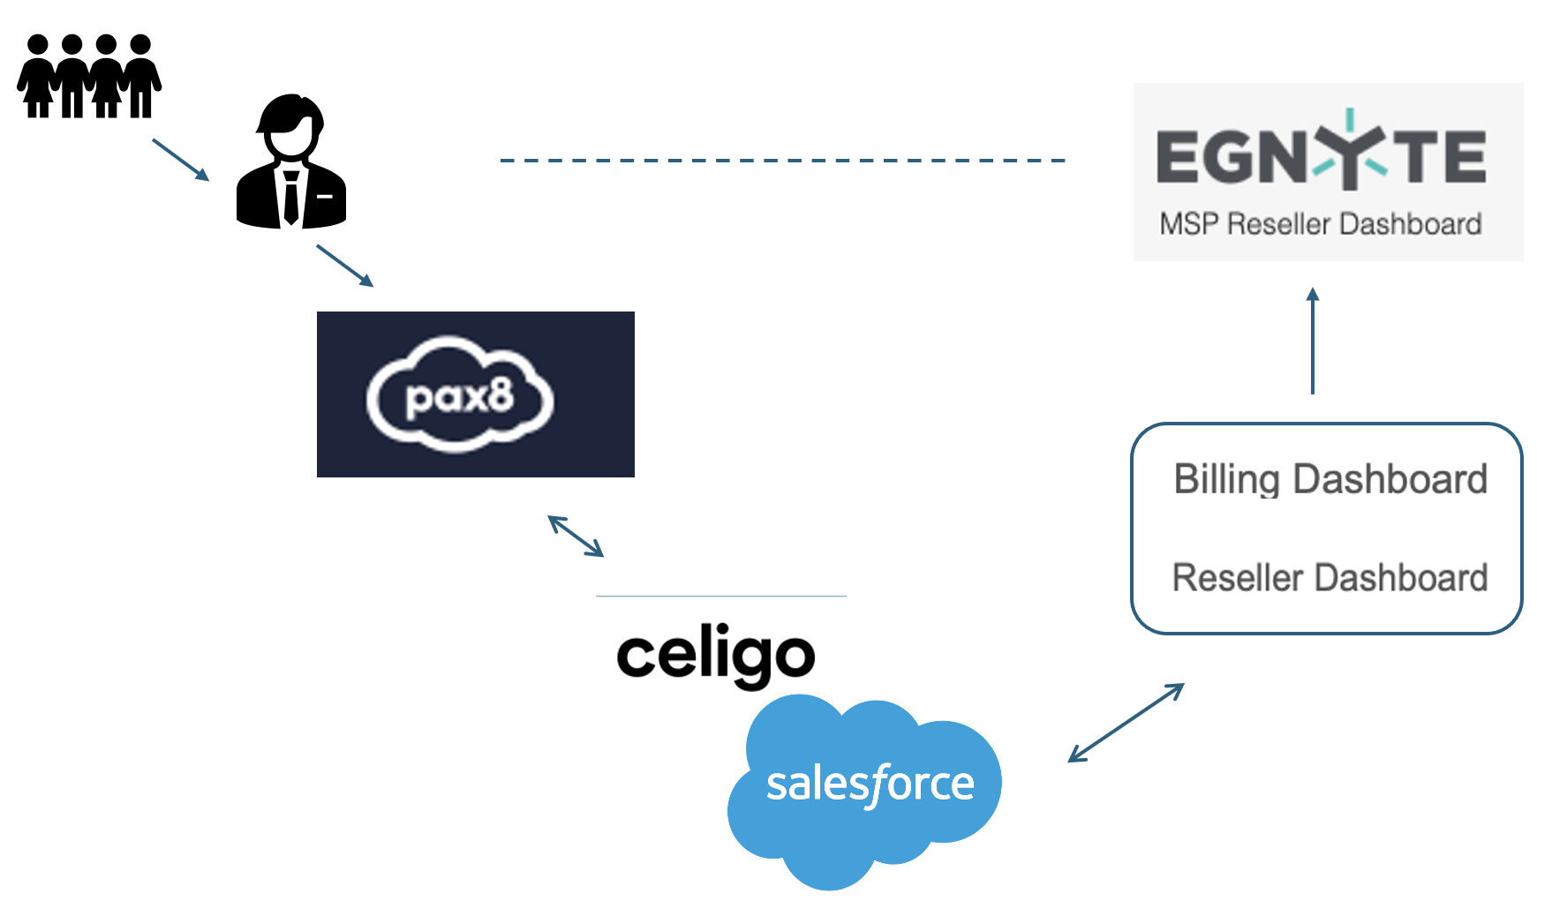
Distributor - Automation phase 1 - MSP Onboard, Create and Convert Trial
Problem Statement
Egnyte integrates with Pax8 through SFDC. SFDC will be the recipient of requests sent from Pax8 and will be a dispatch system to provide deployment requests and data to downstream systems.
Reseller and Billing apps need to be prepared to respond to such requests and act accordingly automatically.
User Story
As Egnyte Internal system I need to provide automated deployment of Egnyte products for Pax8 Managed MSPs so that deployment requests can be done without manual support from the Finance Team.
Feature Description
• Provide automated deployment for first part of transactions requested from SFDC:
• starting a trial
• converting a trial to paid domain
• update plan for Power users and storage accordingly
View in Productboard
APPS-12970
Link to requirements

Slide 128
Distributor - Automation phase 2 - Upsell and Downsell
Problem Statement
Egnyte integrates with Pax8 through SFDC. SFDC will be the recipient of requests sent from Pax8 and will be a dispatch system to provide deployment requests and data to downstream systems.
Reseller and Billing apps need to be prepared to respond to such requests and act accordingly automatically.
User Story
As Egnyte Internal system I need to provide automated deployment of Egnyte products for Pax8 Managed MSPs so that deployment requests can be done without manual support from the Finance Team.
Feature Description
• Provide automated deployment for second part of transactions requested from SFDC for the distributor related partners related to:
• any upsell and downsell allowed in the Usage Details tab of the MSP RD UI
• change of plan for the child domain
View in Productboard
APPS-13483
Link to requirements

Slide 129
Autonomous Agents & Augmenting Copilot

Slide 130
AI Prompt workflow step
Problem Statement
Document-based workflows often rely on manual review to extract insights, which slows down operations and introduces inconsistency across teams. There's a growing need to scale knowledge extraction without adding headcount.
User Story
As an Egnyte user managing content workflows, I want to automatically execute customer-provided GenAI prompts within documents, so that I can generate structured metadata, comments, or insights without manual effort.
Feature Description
• Integrate GenAI into document workflows to extract structured outputs (e.g., metadata, workflow comments)
• Support flexible prompt injection from users or templates for targeted insight generation
• Reduce time to insight and improve consistency across teams handling unstructured content
View in Productboard
CFS-66199
Link to requirements

Slide 131
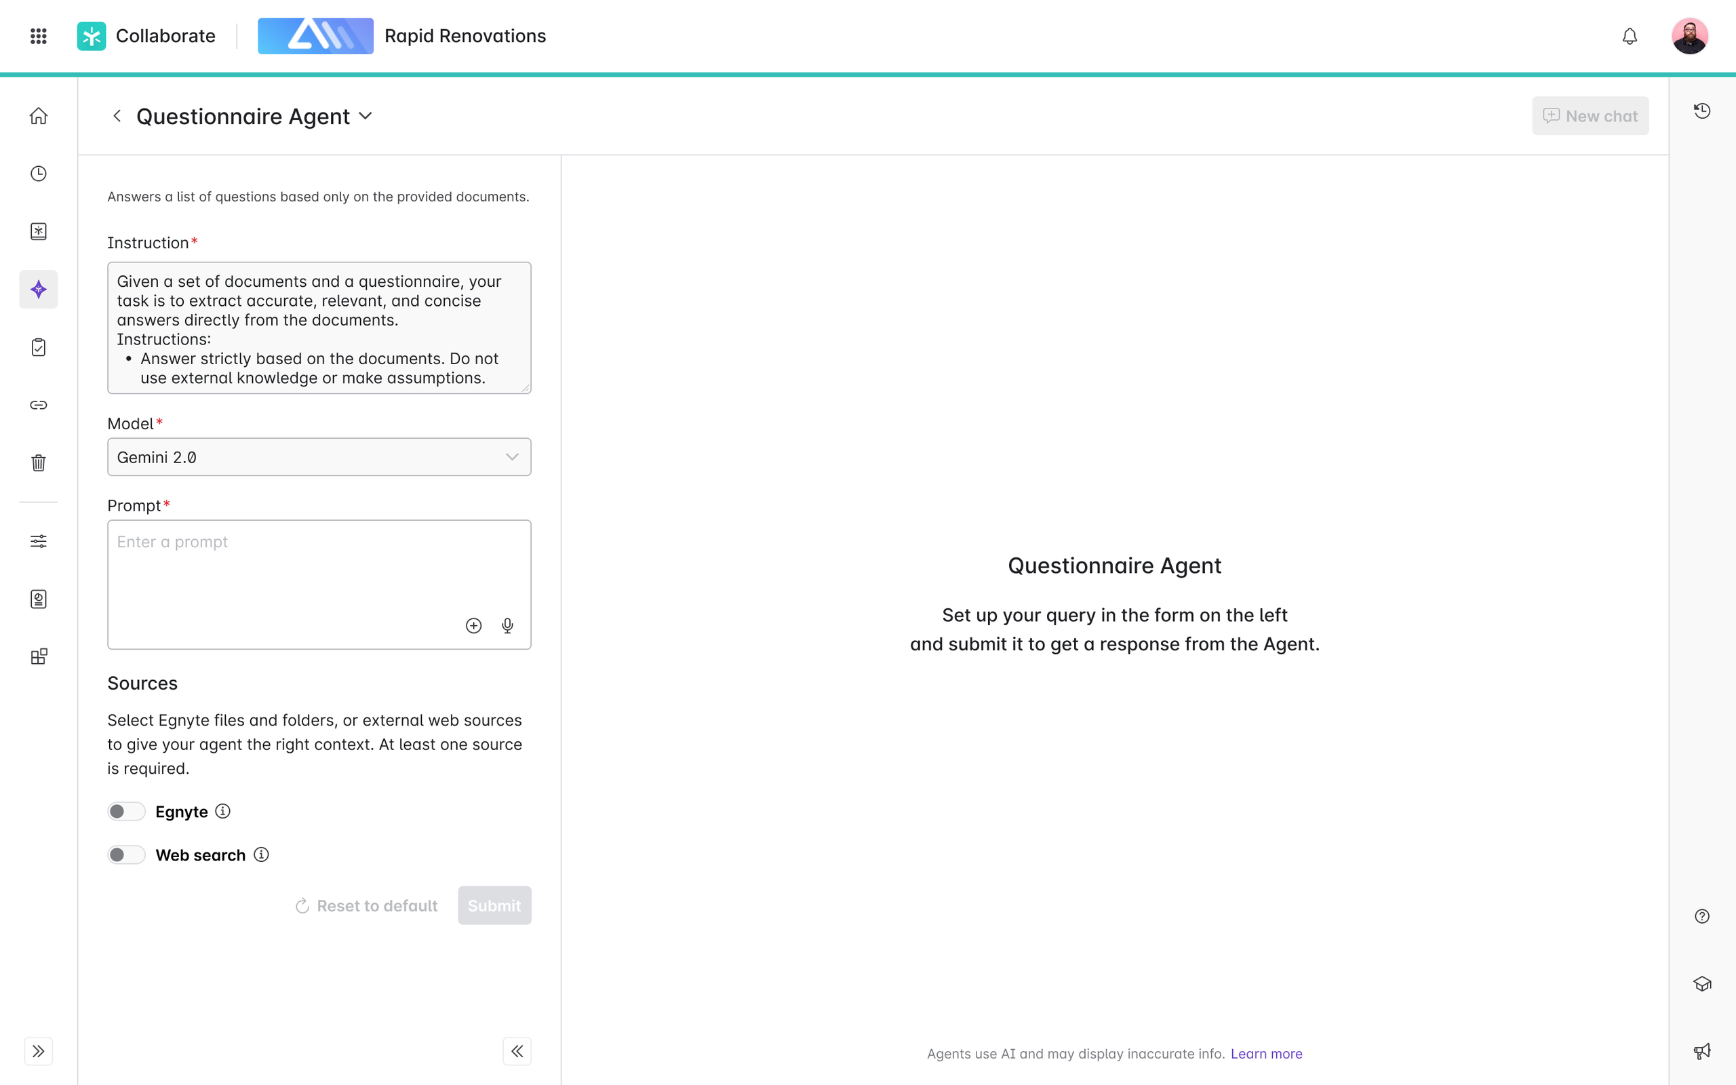
[Agent] Questionnaire Agent (Bryce)
Problem Statement
Users frequently receive lists of questions from clients regarding products, services, and compliances, which require significant time and effort to answer. Often, these questions have already been answered in previous requests or can be found in existing documents. The repetitive nature of this task hinders productivity and wastes valuable time.
User Story
As a user, I want to submit a list of questions (text, excel, pdf, doc) to a Questionnaire Agent and point it to a collection of documents in Egnyte (files or folders) that contain the answers. I expect the Q&A response (text or a document) to be ready for my review, with unanswered questions highlighted for easy review and completion. I should be able to submit the response on Egnyte and further edit it as needed.
Value Statement
• Time Efficiency: Automates the process of finding answers to repetitive questions, significantly reducing the time spent on each information request.
• Enhanced Productivity: Allows users to focus on higher-value tasks by freeing them from the repetitive chore of answering similar questions.
Requirements
https://egnyte.atlassian.net/wiki/spaces/CFS/pages/1471152191/Questionnaire+Agent?force_transition=e7e56be6-04a5-4088-bb89-a71bc2d9bb13
More context in slack channels: #ddq-agent
View in Productboard
CFS-67393
Link to requirements

Slide 132
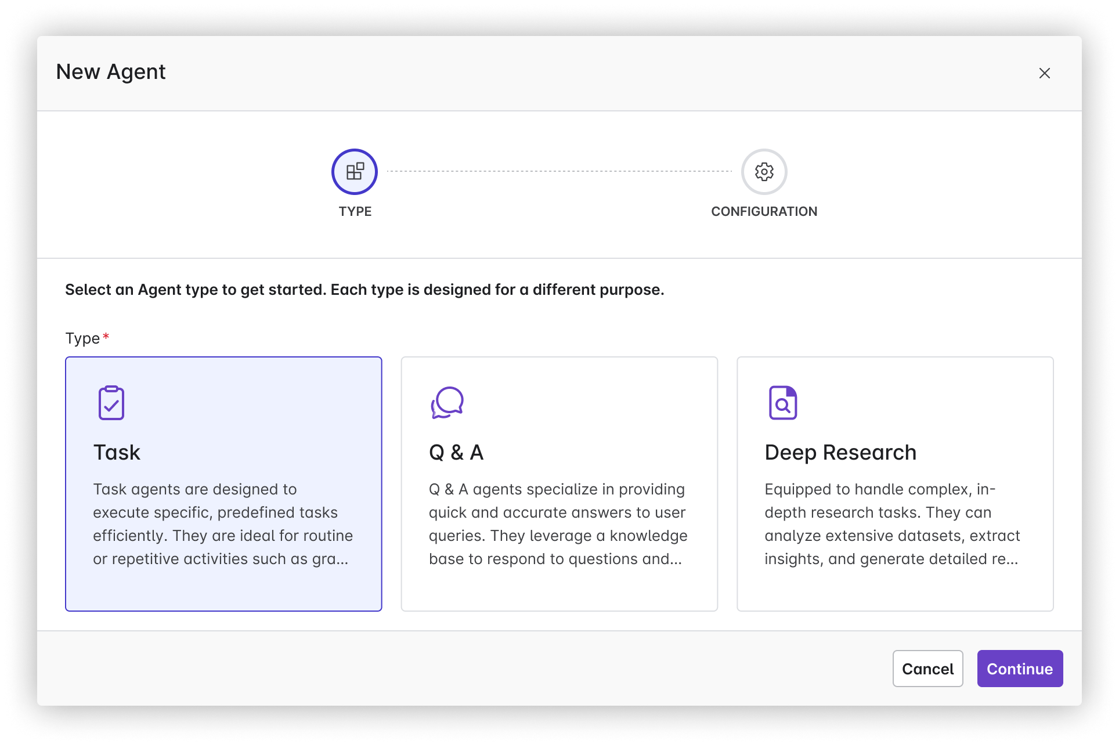
[Agent] Deep Research Agent (Bryce)
Problem Statement
Businesses and researchers often struggle with the time-consuming task of conducting in-depth analysis and research, such as finding historical data or identifying trends from previous projects. This lack of efficiency can delay decision-making processes, harming productivity.
User Story
As a business analyst, I want a Deep Research Agent that can quickly identify similar proposals and investments by analyzing historical data, so that I can accelerate the research process and make more informed decisions based on past trends.
Value Statement
• Time Savings: Automates the labor-intensive process of sifting through historical data, drastically reducing the time spent on research from months to mere days or hours.
• Increased Productivity: Allows employees to focus on higher-value tasks by automating repetitive research activities.
• Cost Efficiency: Reduces the need for extensive manual labor, resulting in lower operational costs associated with research and analysis.
View in Productboard
CFS-67394
Link to requirements

Slide 133
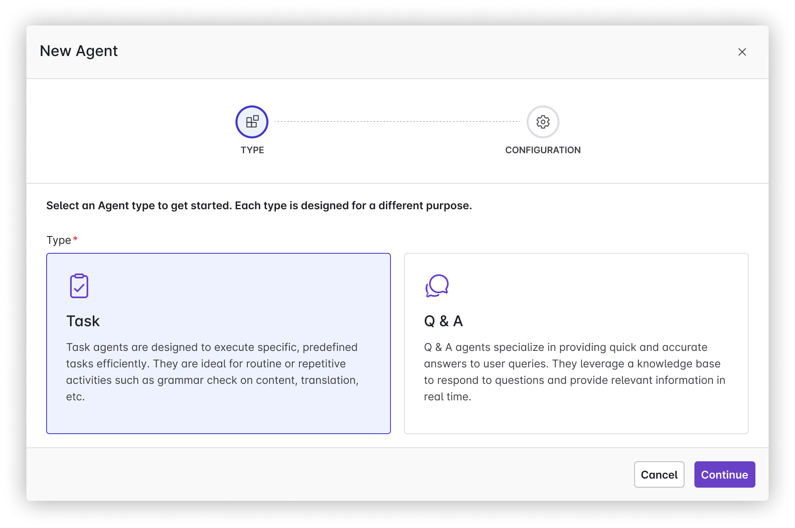
[Agent] Custom Agents in Copilot hub
Problem Statement:
Many businesses are burdened by time-consuming and repetitive tasks that reduce overall productivity and employee engagement. This inefficiency prevents employees from focusing on higher-value work that could contribute more significantly to the company's growth and success.
User story:
As a business owner, I want AI agents to automate repetitive and time-consuming tasks so that my employees can focus on strategic and creative efforts that drive the business forward.
Value Statement:
• 24/7 operational capability, ensuring tasks are completed even outside regular business hours.
• Increased productivity as employees can refocus their time on more valuable activities.
Requirements:https://egnyte.atlassian.net/wiki/spaces/CFS/pages/1227161693/Agents+Introduction+in+Egnyte+Platform+WIP#Create-your-own-Agent
Figma Link
Embedded content
View in Productboard
No Jira Link
Link to requirements

Slide 134
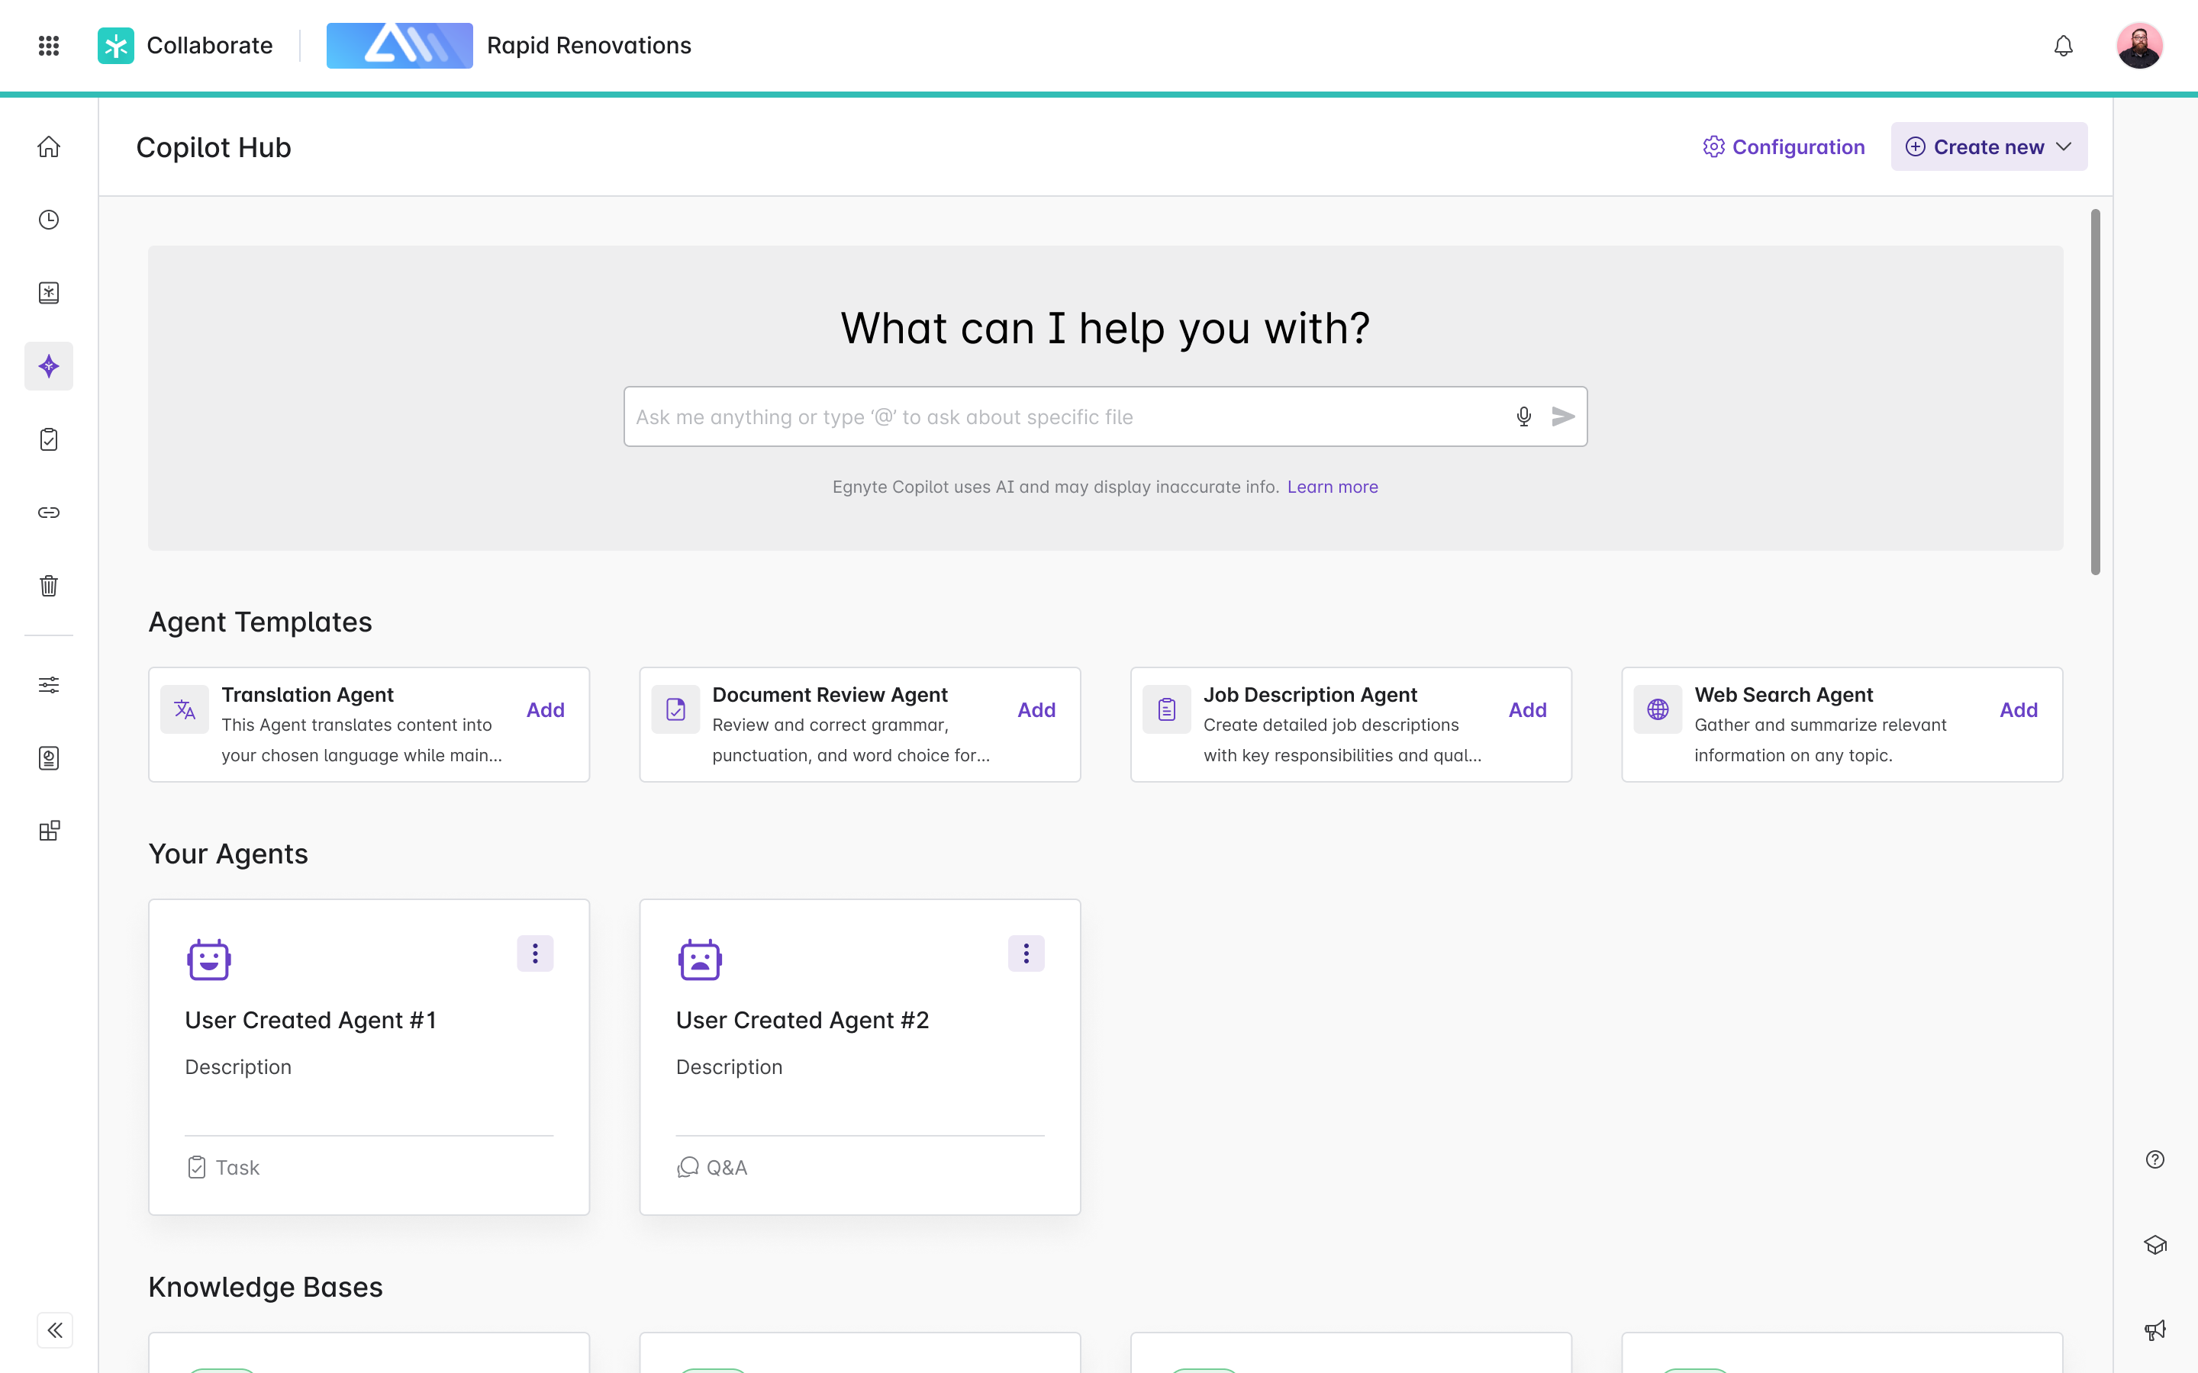
[Agent] Agent Templates in Copilot hub
Problem Statement
New users often face challenges when adopting AI agents due to lack of familiarity and difficulty in configuring them to meet specific needs. This initial barrier can slow down the adoption process, reducing the potential benefits of task automation.
User Story
As a new user of the AI Agents platform, I want pre-configured agent templates available at the start, so that I can quickly set up and begin using these tools without needing extensive customization, thereby experiencing the benefits of automation sooner.
Value Added
• Faster Onboarding: New users can quickly get started with minimal setup time, which reduces the learning curve and speeds up adoption.
• Ease of Use: Pre-configured templates simplify the initial experience, making it less intimidating for users who are not tech-savvy.
• Immediate ROI: Users can achieve immediate productivity gains from automation, showcasing the value of AI agents promptly.
• Flexibility: While templates provide a good starting point, they can be customized later as users become more comfortable with the platform.
• Increased User Satisfaction: Easy access to ready-made solutions enhances user experience and satisfaction, encouraging continued use and exploration of more advanced functionalities.
Agent Template examples:
• Translation Agent:
• Document Review Agent:
• Job Description Creation Agent:
• Web Search Agent:
Requirements
https://egnyte.atlassian.net/wiki/spaces/CFS/pages/1227161693/Agents+Introduction+in+Copilot+Hub
Figma:
https://www.figma.com/design/k96o3kXukaVrAUtsaPhN4H/Egnyte-Platform-Copilot---2025?node-id=24179-230269&t=Rc2JPK6PsbVBlXNe-0
Design:
https://egnyte.atlassian.net/wiki/spaces/CFS/pages/1304788999/Agents+Integration
Feature flags:
*server.SmartAppAgentsPowerUserAccessEnabled*
*server.SmartAppAgentsEnabled*
View in Productboard
CFS-65268
Link to requirements

Slide 135
Specialized Agents - AEC

Slide 136
Smart Specifications - In Product Version
Problem:
Construction specifications are extremely long, detailed and complex PDF's accessed by different user-roles such as Project Managers, Estimators, VDC and more. Users find it challenging to locate and extract relevant information from the Specs.
User Stories:
1. As a Project Manager / Estimator / VDC team member, I want to open the Smart Spec preview when selecting my specification files, so that I can quickly find the section I’m looking for
2. As a PM / Estimator / VDC, I want to ask a natural language query about my specification, so that I can quickly find the information I am looking for.
Description:
Egnyte's AEC doc-classification will automatically identify and tag Specs within a project. When a user clicks on the tagged specification in WebUI, the Smart Specs will automatically load in the preview pane. The user will see all the sections within the Spec on the left panel. When they click on a specific section in the left panel, the center panel will open that specific section. On the right panel, they can ask natural language queries on the spec.
Requirements:https://egnyte.atlassian.net/wiki/spaces/AEC/pages/446464310/Smart+Specification+Requirements
Figma
https://www.figma.com/design/pSP6gVOM1NB1dORHzVw1k5/AEC-Trial-Onboarding?node-id=7-17521&node-type=frame&t=2GCW5Ubc2U9ardCl-0
JIRA:https://jira.egnyte-it.com/browse/CFS-60040
FEATURE FLAG:features.server.SmartSpecFeatureEnabled
View in Productboard
CFS-60040
Link to requirements

Slide 137
[Agent] Codebooks Agent for AEC
Problem:
Users in the AEC industry require to follow regulations and standards during the design / construction / maintenance of structures and these are stipulated as building codes. These building codes are extremely long, detailed and complex, can vary by local jurisdictions and can change from year to year. Due to these factors, users often face the challenge of finding the right code information pertaining to a project, and using that information to validate project specifications, submittals and other project docs.
Use-Cases:
1. As a project engineer / field engineer, I want to easily get answers to regulatory questions, such ashow many ADA accessible parking spots do I need if my parking lot has 100 total parking spaces?
2. As a project coordinator, I want to easily validate a spec against regulations/codes- validate this stairwell design for fire safety regulation compliance
Description:
We will create a specialized agent, the code books agent, which the admin can configure to read one or more code books at a specific location on their Egnyte domain. Once configured, users can ask questions against the code book agent from the WebUI or desktop
View in Productboard
CFS-64858
Link to requirements

Slide 138
Augment Metadata

Slide 139
[Metadata] Trainable Classifier Enhancements
Problem:
View in Productboard
No Jira Link
Link to requirements

